Slide 1

Chapter 13
Gravitation
Notes:
1

Slide 2
13-1 Newton's Law of Gravitation
Learning Objectives
13.01 Apply Newton's law of gravitation to relate the gravitational force between two particles to their masses and their separation.
13.02 Identify that a uniform spherical shell of matter attracts a particle that is outside the shell as if all the shell's mass were concentrated as a particle at its center.
13.03 Draw a free-body diagram to indicate the gravitational force on a particle due to another particle or a uniform, spherical distribution of matter.
Notes:
2

Slide 3
13-1 Newton's Law of Gravitation
The gravitational force
  Holds us to the Earth
  Holds Earth in orbit around the Sun
  Holds the Sun together with the stars in our galaxy
  Reaches out across intergalactic space to hold together the Local Group of galaxies
  Holds together the Local Supercluster of galaxies
  Pulls the supercluster toward the Great Attractor
  Attempts to slow the expansion of the universe
  Is responsible for black holes
Gravity is far-reaching and very important!
Notes:
3

Slide 4
13-1 Newton's Law of Gravitation
Gravitational attraction depends on the amount of “stuff” an object is made of
Earth has lots of “stuff” and produces a large attraction
The force is always attractive, never repulsive
Gravitation is the tendency for bodies to attract each other
Newton realized this attraction was responsible for maintaining the orbits of celestial bodies
Newton's law of gravitation defines the strength of this attractive force between particles
For apple & Earth: 0.8 N; for 2 people: < 1 μN
Notes:
4

Slide 5
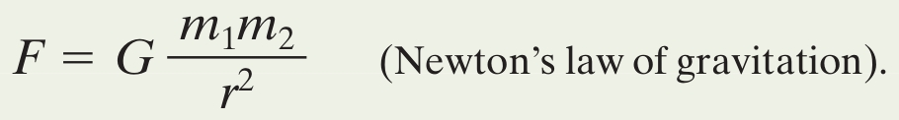
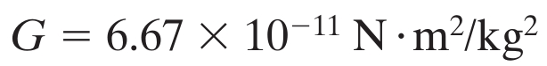
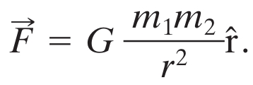
13-1 Newton's Law of Gravitation
The magnitude of the force is given by:
Where G is the gravitational constant:
The force always points from one particle to the other, so this equation can be written in vector form:
Eq. (13-1)
Eq. (13-2)
Eq. (13-3)
Notes:
5

Slide 6
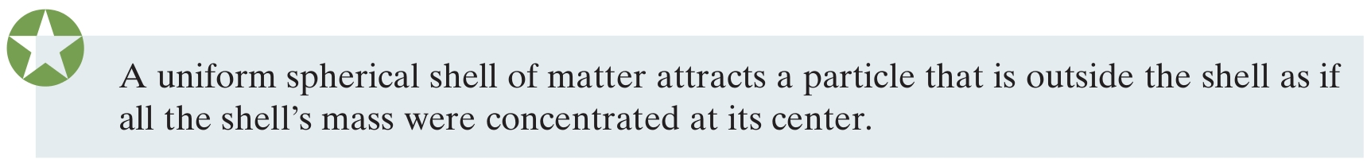
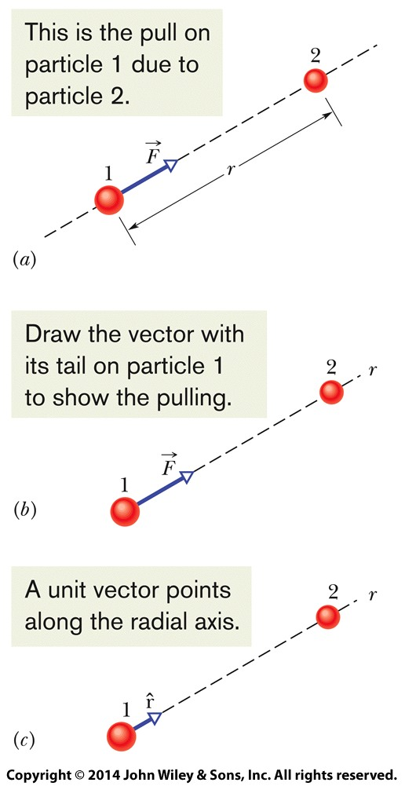
13-1 Newton's Law of Gravitation
The shell theorem describes gravitational attraction for objects
Earth is a nesting of shells, so we feel Earth's mass as if it were all located at its center
Gravitational force forms third-law force pairs
E.g., Earth-apple and apple-Earth forces are both 0.8 N
Figure 13-2
Notes:
6

Slide 7
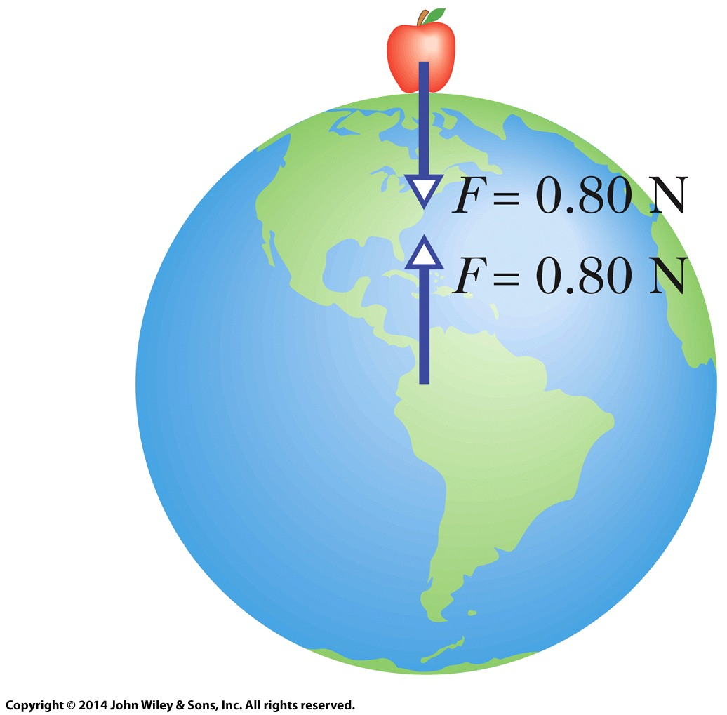
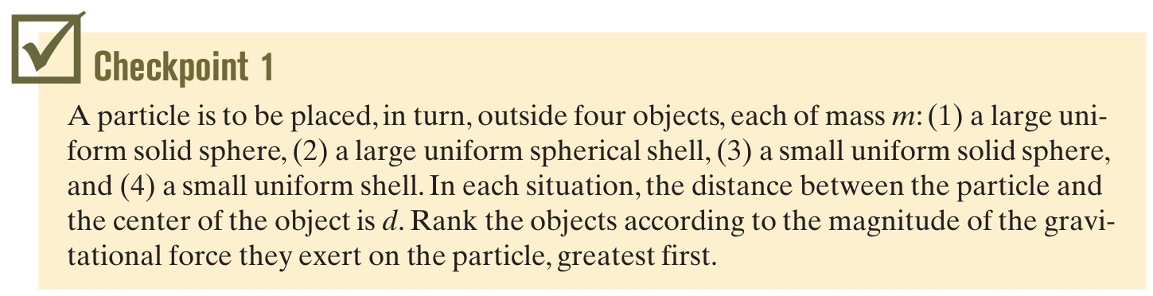
13-1 Newton's Law of Gravitation
The difference in mass causes the difference in the apple:Earth accelerations:
~10 m/s² vs. ~ 10⁻²⁵ m/s²
Figure 13-3
Answer: All exert equal forces on the particle
Notes:
7

Slide 8
13-2 Gravitation and the Principle of Superposition
Learning Objectives
13.04 If more than one gravitational force acts on a particle, draw a free-body diagram showing those forces, with the tails of the force vectors anchored on the particle.
13.05 If more than one gravitational force acts on a particle, find the net force by adding the individual forces as vectors.
Notes:
8

Slide 9
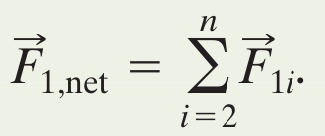
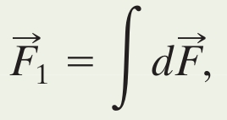
13-2 Gravitation and the Principle of Superposition
Find the net gravitational force by the principle of superposition: the net is the sum of individual effects
Add the individual forces as vectors:
For a real (extended) object, this becomes an integral:
If the object is a uniform sphere or shell we can treat its mass as being at its center instead
Eq. (13-5)
Eq. (13-6)
Notes:
9

Slide 10
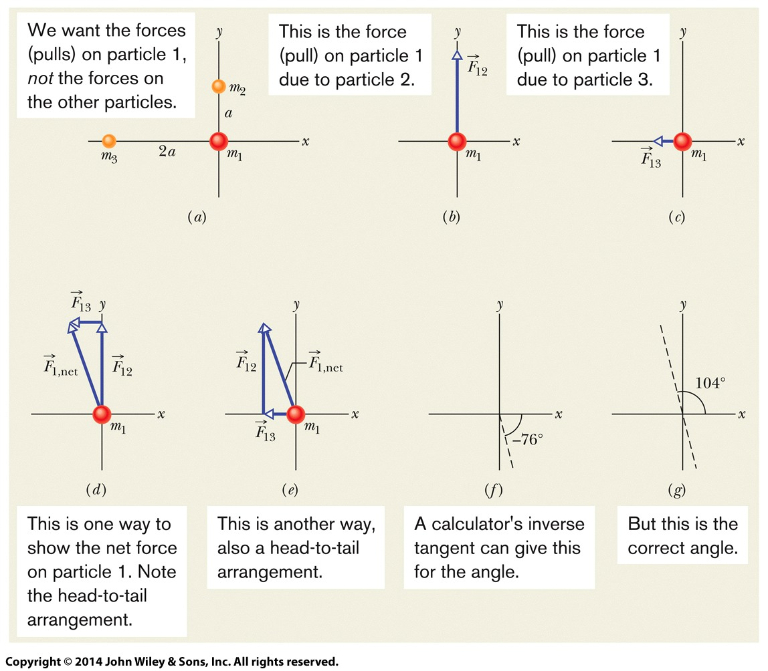
13-2 Gravitation and the Principle of Superposition
Example Summing two forces:
Figure 13-4
Notes:
10

Slide 11
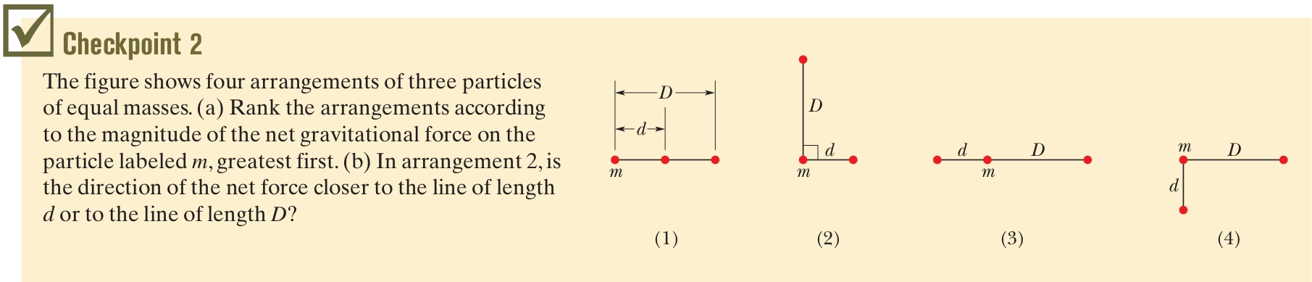
13-2 Gravitation and the Principle of Superposition
Answer: (a) 1, 2 & 4, 3 (b) line of length d
Notes:
11

Slide 12
13-3 Gravitation Near Earth's Surface
Learning Objectives
13.06 Distinguish between the free-fall acceleration and the gravitational acceleration.
13.07 Calculate the gravitational acceleration near but outside a uniform, spherical astronomical body.
13.08 Distinguish between measured weight and the magnitude of the gravitational force.
Notes:
12

Slide 13
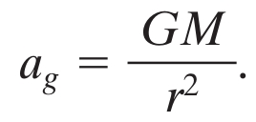
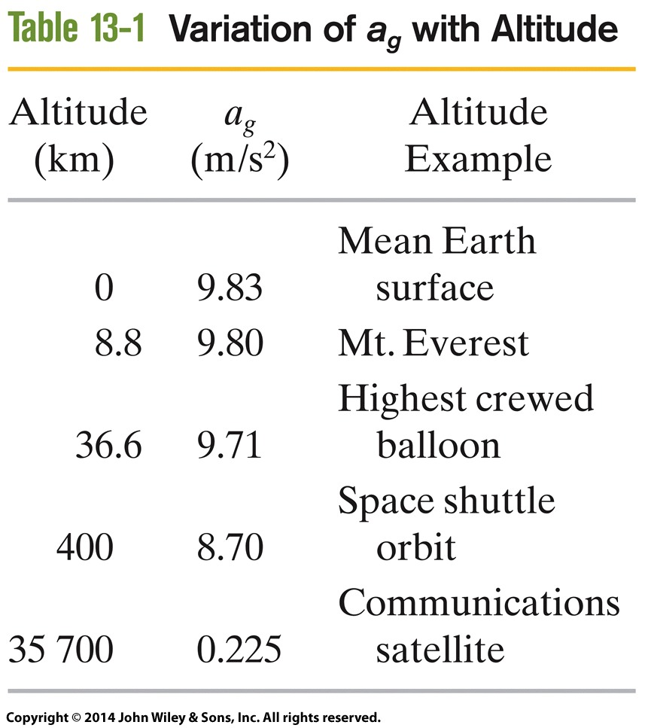
13-3 Gravitation Near Earth's Surface
Combine F = GMm/r² and F = ma_{g}:
This gives the magnitude of the gravitational acceleration at a given distance from the center of the Earth
Table 13-1 shows the value
for a_{g} for various altitudes above the Earth’s surface
Eq. (13-11)
Table 13-1
Notes:
13

Slide 14
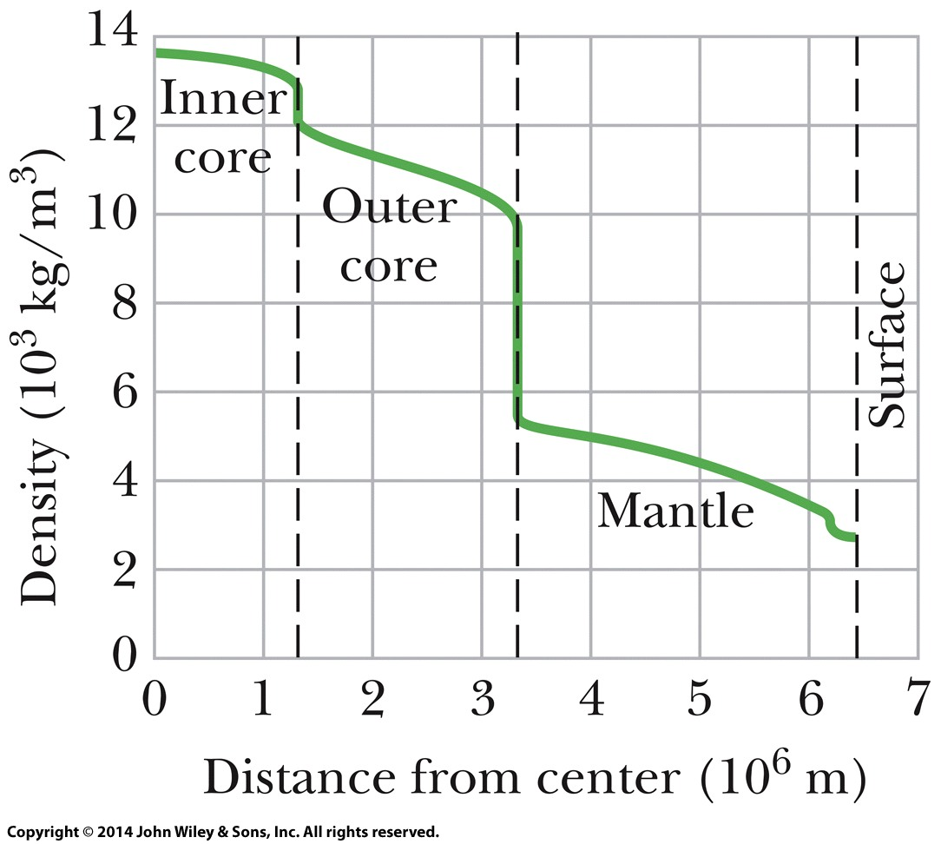
13-3 Gravitation Near Earth's Surface
The calculated a_{g} will differ slightly from the measured g at any location
Therefore the calculated gravitational force on an object will not match its weight for the same 3 reasons:
  Earth's mass is not uniformly distributed, Fig. 13-5
  Earth is not a sphere
  Earth rotates
Figure 13-5
Notes:
14

Slide 15


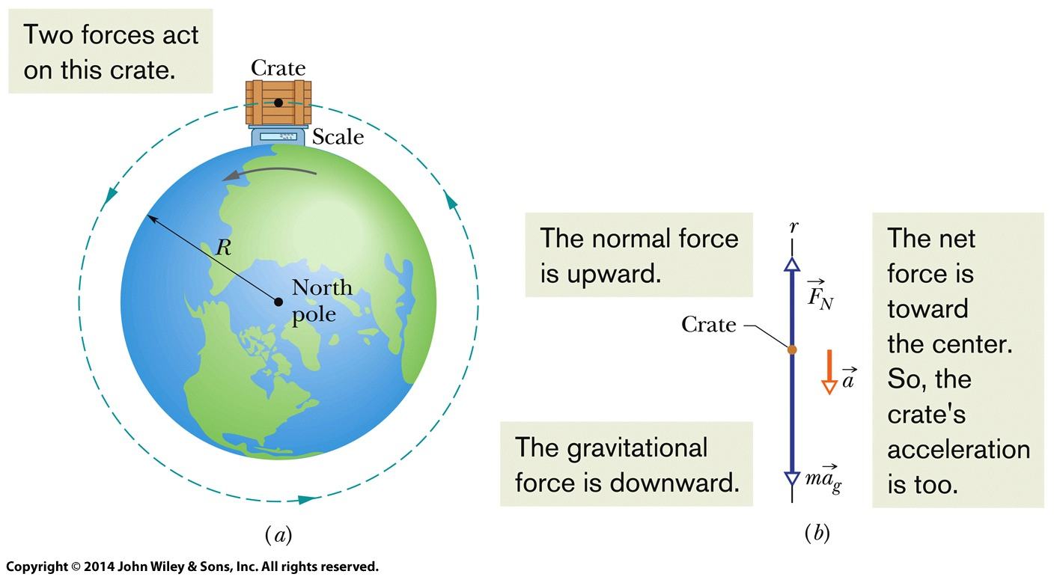
13-3 Gravitation Near Earth's Surface
Example Difference in gravitational force and weight due to rotation at the equator:
Eq. (13-12)
Eq. (13-14)
Figure 13-6
Notes:
15

Slide 16
13-4 Gravitation Inside Earth
Learning Objectives
13.09 Identify that a uniform shell of material exerts no net gravitational force on a particle located inside it.
13.10 Calculate the gravitational force that is exerted on a particle at a given radius inside a nonrotating uniform sphere of matter.
Notes:
16

Slide 17
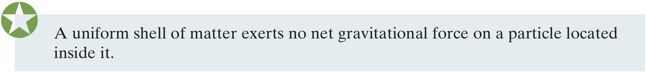
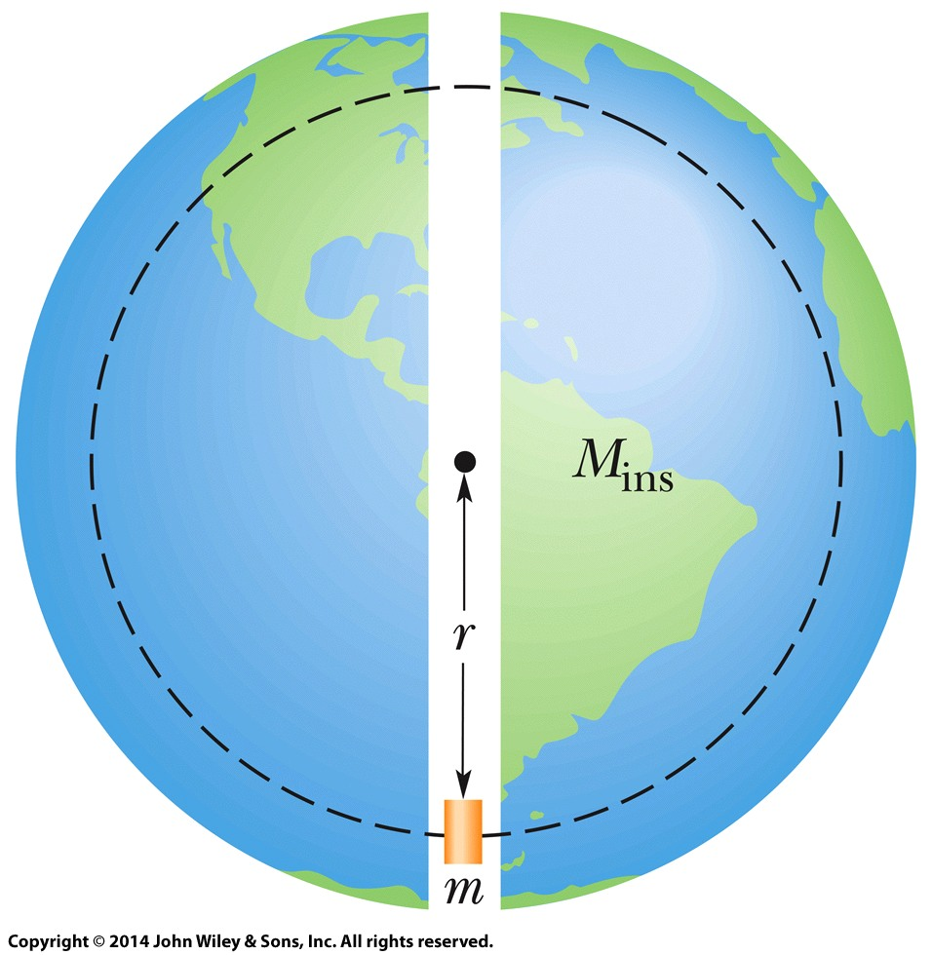
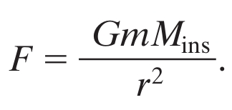
13-4 Gravitation Near Earth's Surface
The shell theorem also means that:
Forces between elements do not disappear, but their vector sum is 0
Let's find the gravitational force inside a uniform-density Earth
a solid sphere, not a shell:
Eq. (13-17)
Figure 13-7
Notes:
17

Slide 18
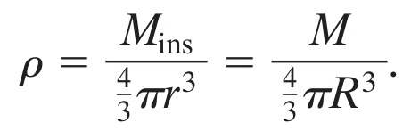
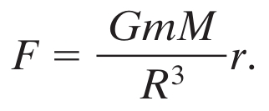

13-4 Gravitation Near Earth's Surface
The constant density is:
Substitute in to Eq. 13-17:
If we write this as a vector equation, substituting K for the constants:
Object dropped through Earth oscillates (Hooke's law)
Eq. (13-19)
Eq. (13-20)
Notes:
18

Slide 19
13-5 Gravitational Potential Energy
Learning Objectives
13.11 Calculate the gravitational potential energy of a system of particles (or uniform spheres that can be treated as particles).
13.12 Identify that if a particle moves from an initial to a final point while experiencing a gravitational force, the work done by that force (and thus the change in gravitational potential energy) is independent of which path is taken.
13.13 Using the gravitational force on a particle near an astronomical body (or some second body that is fixed in place), calculate the work done by the force when the body moves.
13.14 Apply the conservation of mechanical energy (including gravitational potential energy) to a particle moving relative to an astronomical body (or some second body that is fixed in place).
Notes:
19

Slide 20
13-5 Gravitational Potential Energy
13.15 Explain the energy requirements for a particle to escape from an astronomical body (assumed to be a uniform sphere).
13.16 Calculate the escape speed of a particle in leaving an astronomical body.

Slide 21
13-5 Gravitational Potential Energy
Note that gravitational potential energy is a property of a pair of particles
We cannot divide it up to say how much of it “belongs” to each particle in the pair
We often speak as of the “gravitational potential energy of an baseball” in the ball-Earth system
We get away with this because the energy change appears almost entirely as kinetic energy of the ball
This is only true for systems where one object is much less massive than the other
Notes:
21

Slide 22
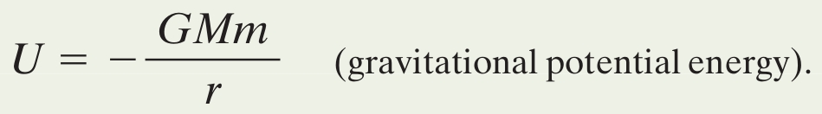
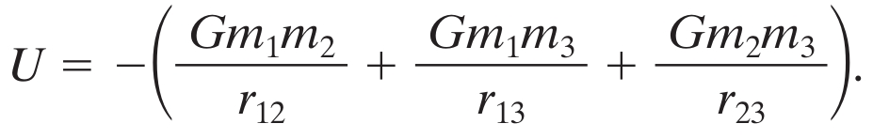
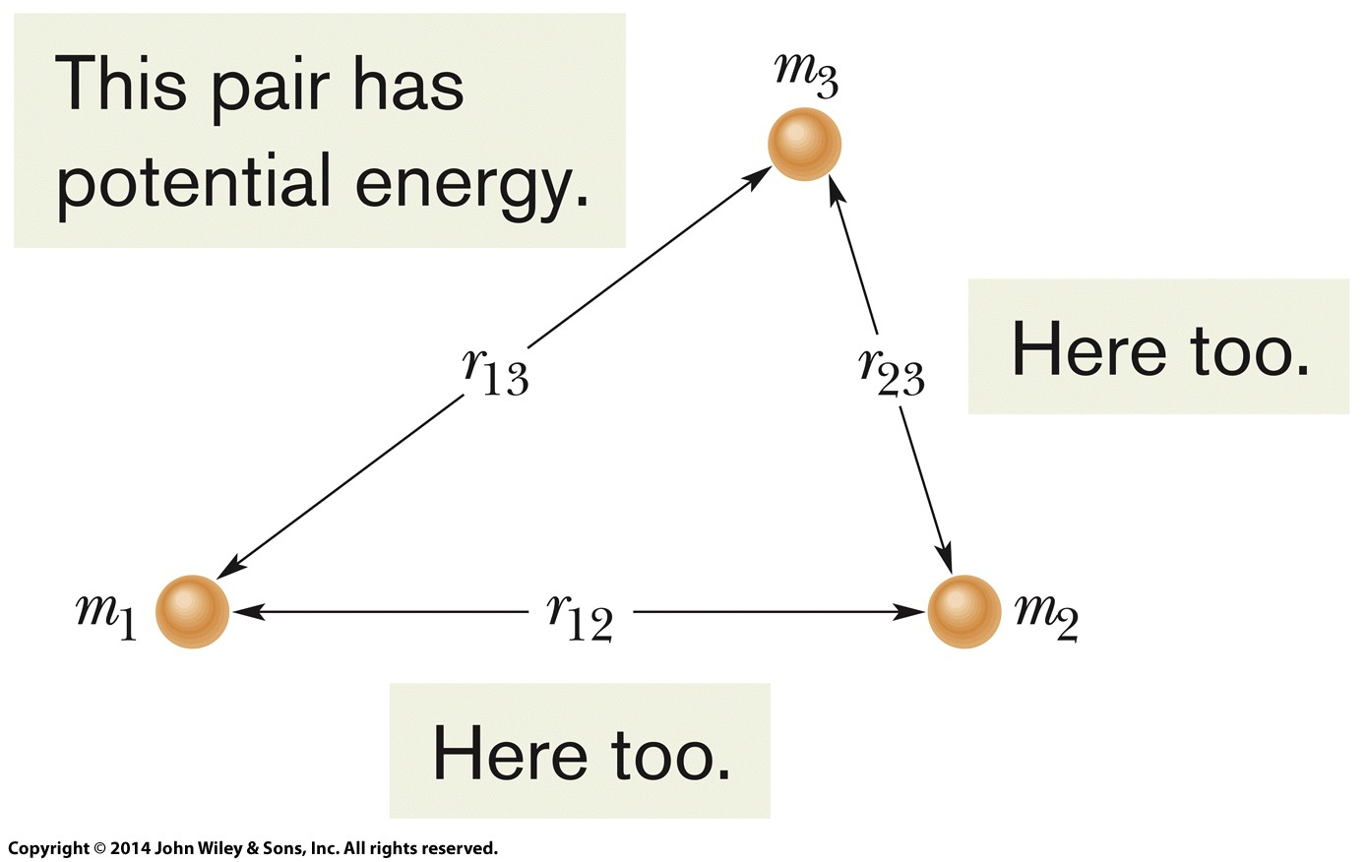
13-5 Gravitational Potential Energy
Gravitational potential energy for a two-particle system is written:
Note this value is negative and approaches 0 for r → ∞
The gravitational potential energy of a system is the sum of potential energies for all pairs of particles
Eq. (13-21)
Eq. (13-22)
Figure 13-8
Notes:
22

Slide 23
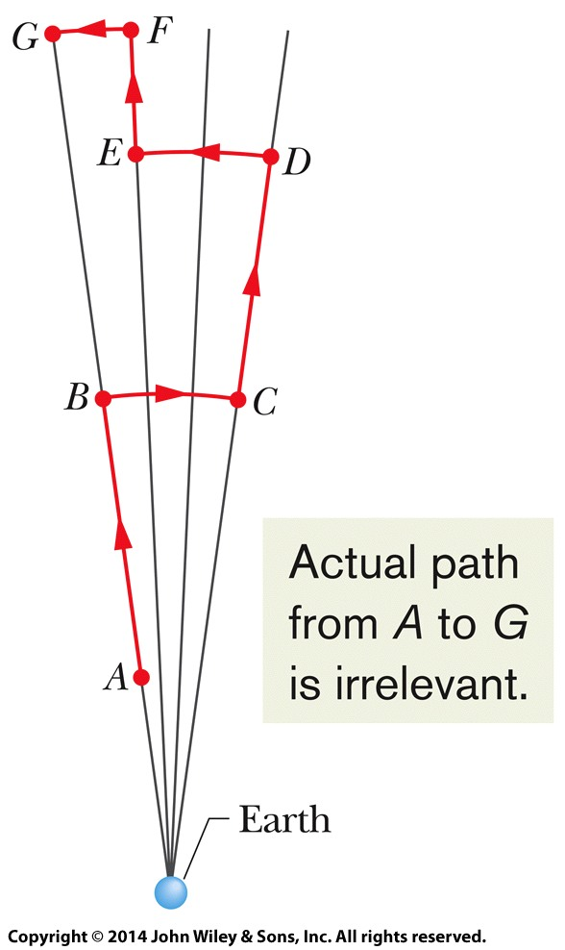

13-5 Gravitational Potential Energy
The gravitational force is conservative
The work done by this force does not depend on the path followed by the particles, only the difference in the initial and final positions of the particles
Since the work done is independent of path, so is the gravitational potential energy change
Eq. (13-26)
Figure 13-10
Notes:
23

Slide 24
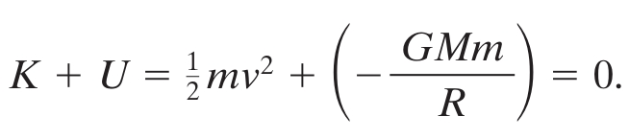
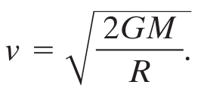
13-5 Gravitational Potential Energy
Newton's law of gravitation can be derived from the potential energy formula by taking the derivative
For a projectile to escape the gravitational pull of a body, it must come to rest only at infinity, if at all
At rest at infinity: K = 0 and U = 0 (because r → ∞)
So K + U must be at least 0 at the surface of the body:
Rockets launch eastward to take advantage of Earth's rotational speed, to reach v more easily
Eq. (13-28)
Notes:
24

Slide 25
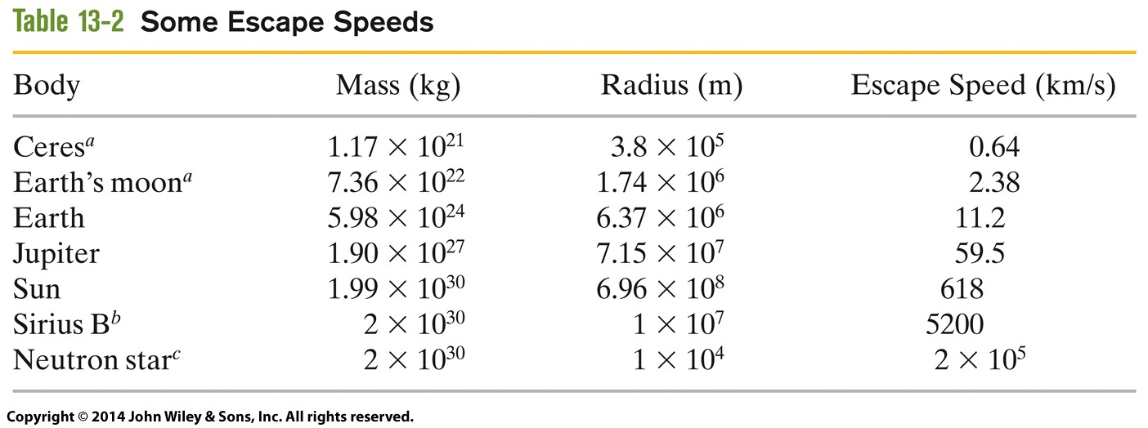
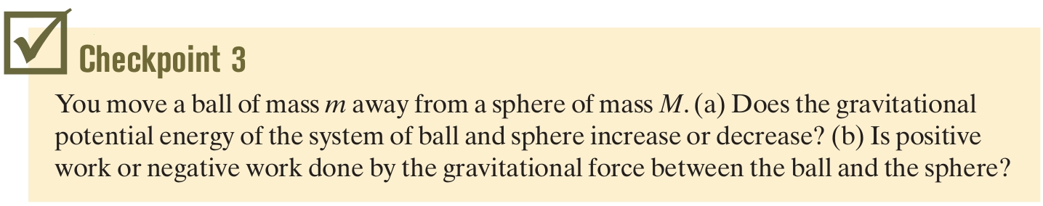
13-5 Gravitational Potential Energy
Table 13-2
Answer: (a) increases (b) negative work
Notes:
25

Slide 26
13-6 Planets and Satellites: Kepler's Laws
Learning Objectives
13.17 Identify Kepler's three laws.
13.18 Identify which of Kepler's laws is equivalent to the law of conservation of angular momentum.
13.19 On a sketch of an elliptical orbit, identify the semimajor axis, the eccentricity, the perihelion, the aphelion, and the focal points.
13.20 For an elliptical orbit, apply the relationships between the semimajor axis, the eccentricity, the perihelion, and the aphelion.
13.21 For an orbiting natural or artificial satellite, apply Kepler's relationship between the orbital period and radius and the mass of the astronomical body being orbited.
Notes:
26

Slide 27
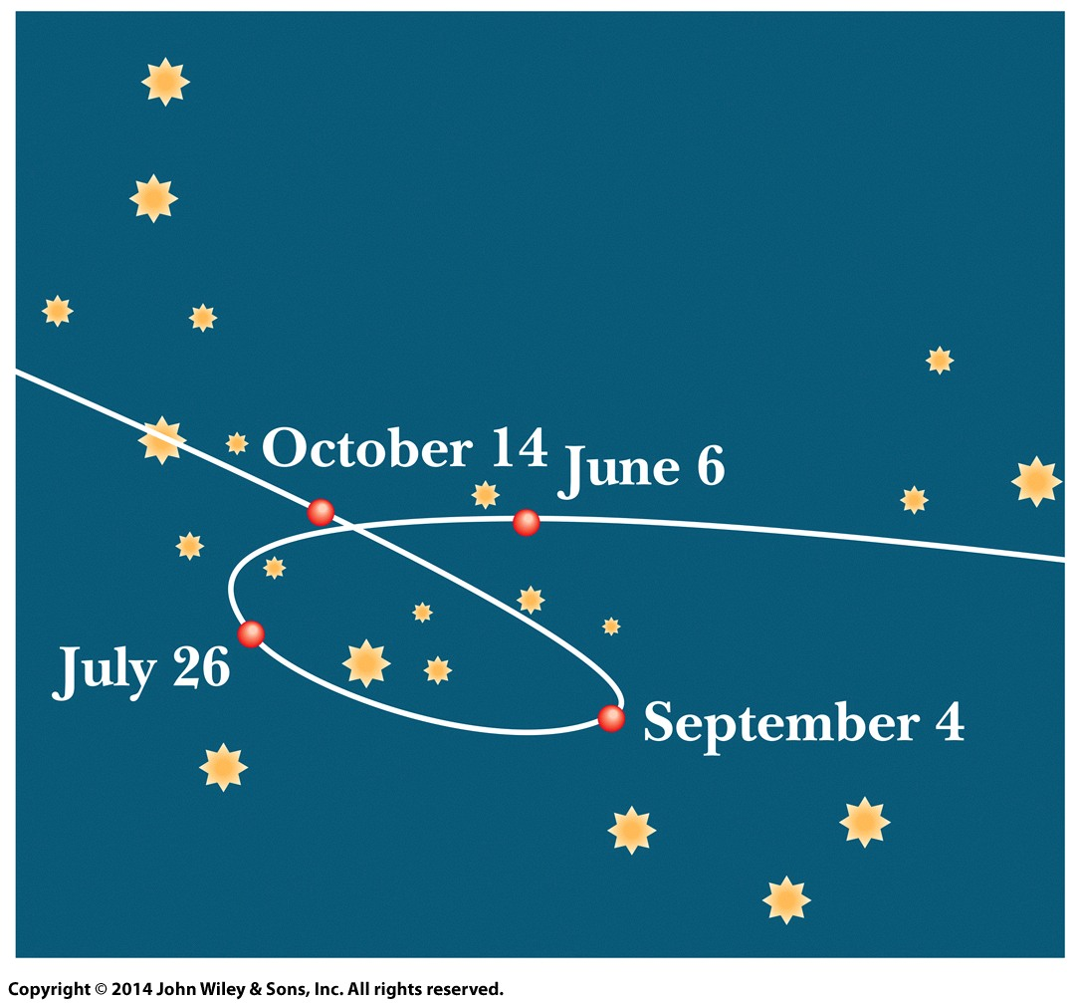
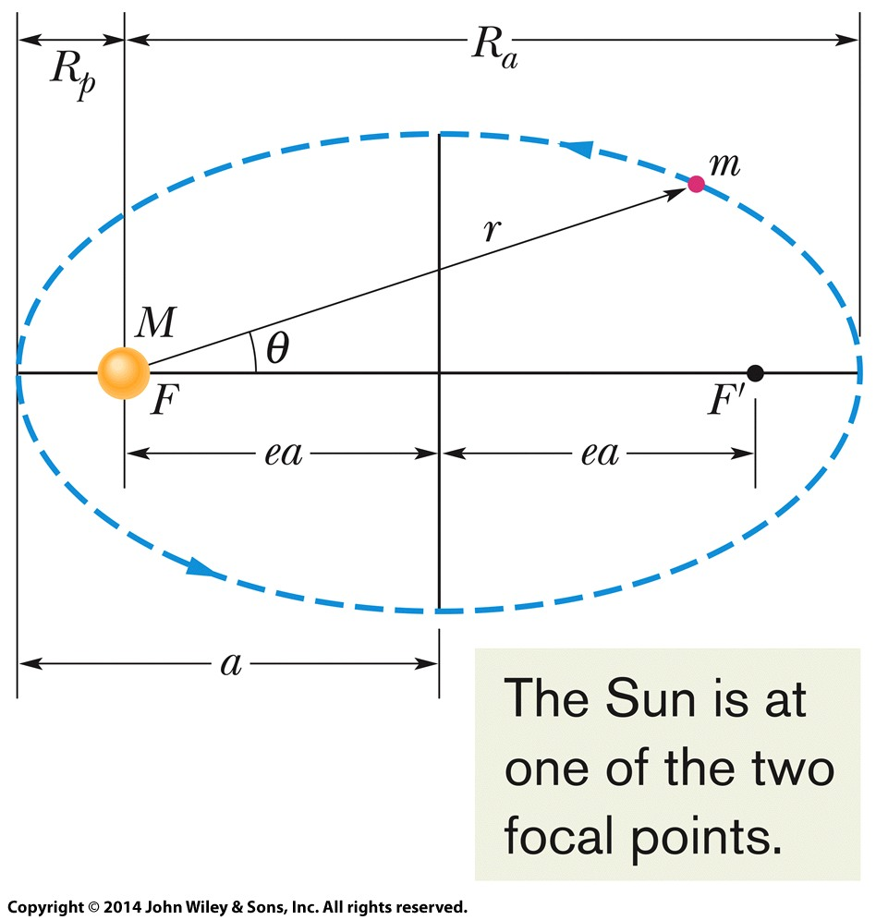
13-6 Planets and Satellites: Kepler's Laws
The motion of planets in the solar system was a puzzle for astronomers, especially curious motions such as in Figure 13-11
Johannes Kepler (1571-1630) derived laws of motion using Tycho Brahe's (1546-1601) measurements
Figure 13-11
Figure 13-12
Notes:
27

Slide 28
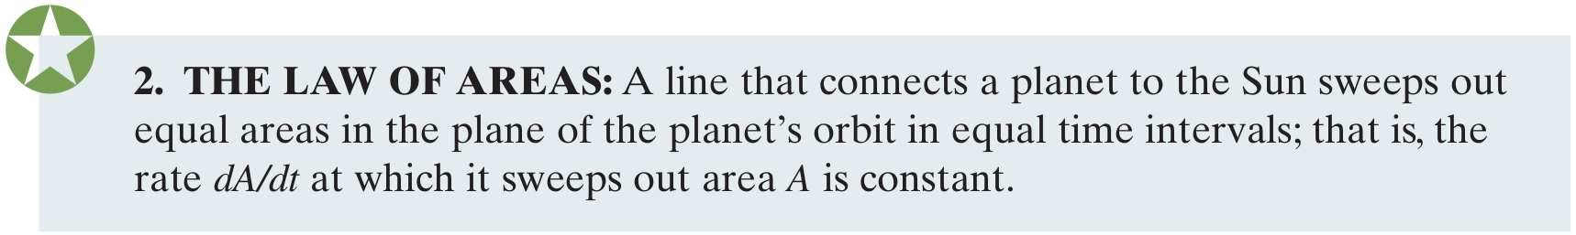
13-6 Planets and Satellites: Kepler's Laws
The orbit is defined by its semimajor axis a and its eccentricity e
An eccentricity of zero corresponds to a circle
Eccentricity of Earth's orbit is 0.0167
Equivalent to the law of conservation of angular momentum
Notes:
28

Slide 29
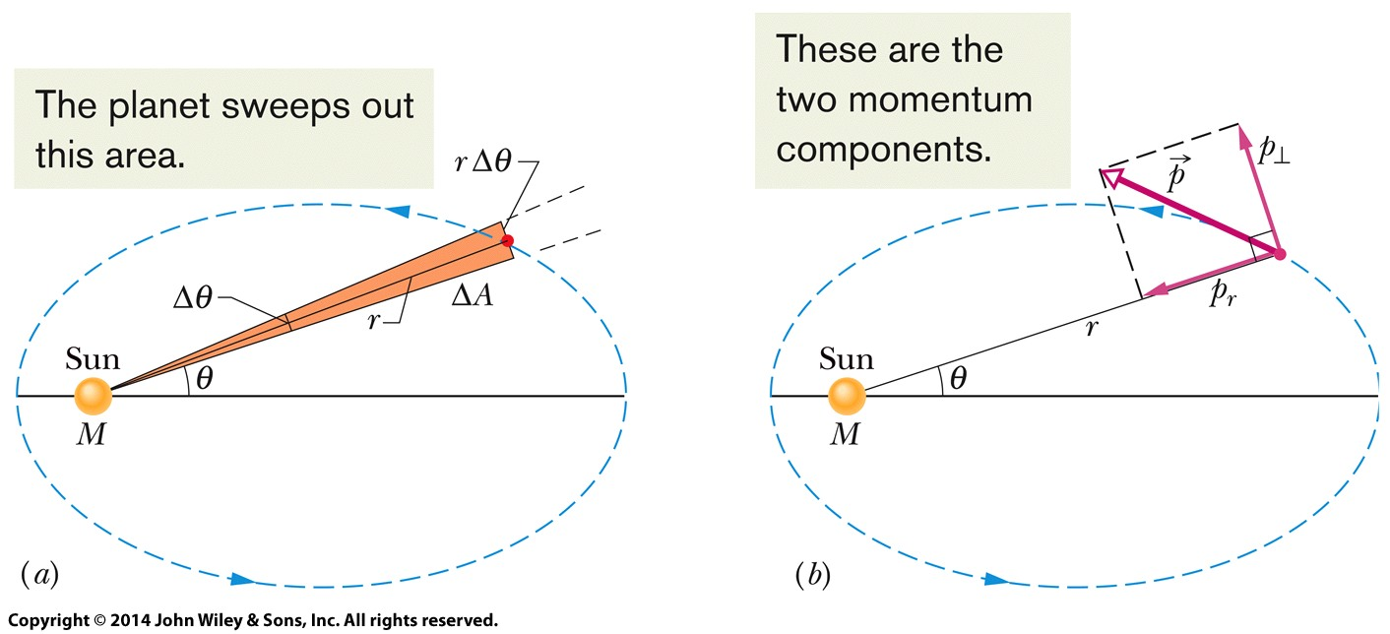
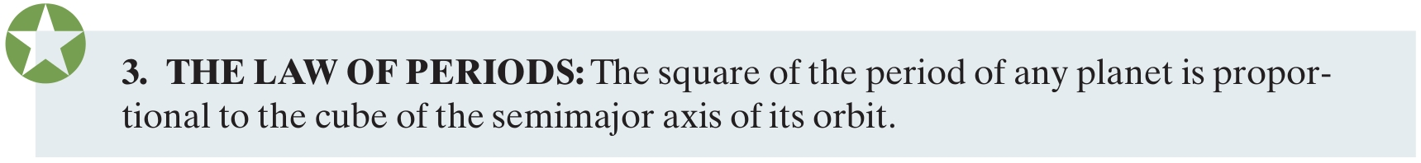
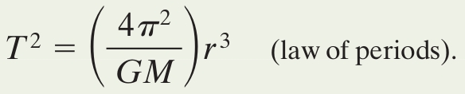
13-6 Planets and Satellites: Kepler's Laws
Figure 13-13
The law of periods can be written mathematically as:
Holds for elliptical orbits if we replace r with a
Eq. (13-34)
Notes:
29

Slide 30
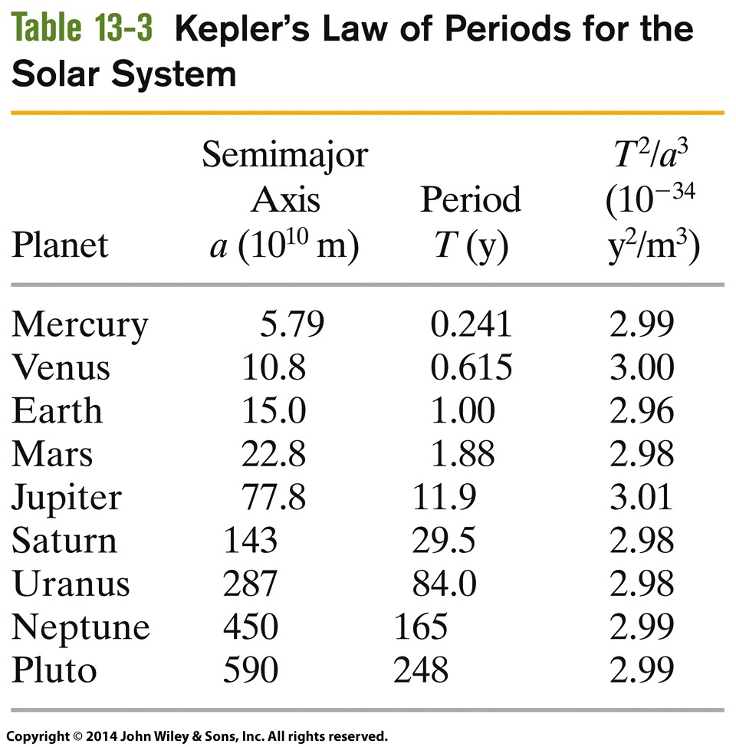
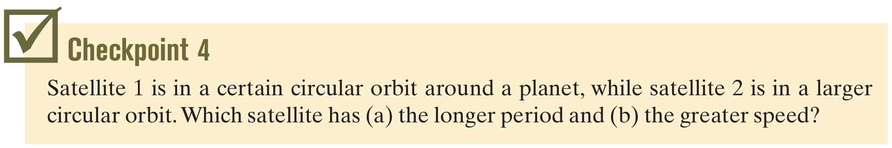
13-6 Planets and Satellites: Kepler's Laws
Table 13-3
Answer: (a) satellite 2 (b) satellite 1
Notes:
30

Slide 31
13-7 Satellites: Orbits and Energy
Learning Objectives
13.22 For a satellite in a circular orbit around an astronomical body, calculate the gravitational potential energy, the kinetic energy, and the total energy.
13.23 For a satellite in an elliptical orbit, calculate the total energy.
Notes:
31

Slide 32
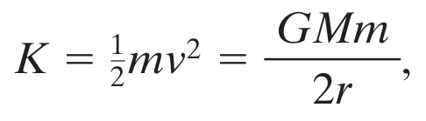
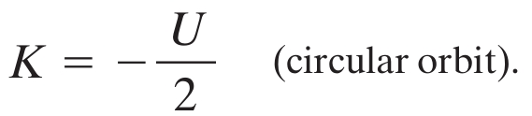
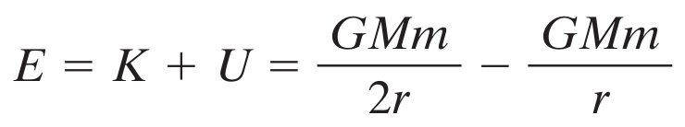
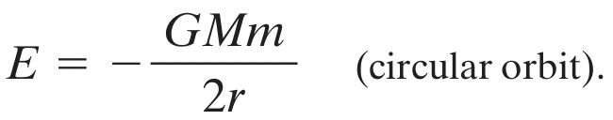
13-7 Satellites: Orbits and Energy
Relating the centripetal acceleration of a satellite to the gravitational force, we can rewrite as energies:
Meaning that:
Therefore the total mechanical energy is:
Eq. (13-38)
Eq. (13-39)
Eq. (13-40)
Notes:
32

Slide 33
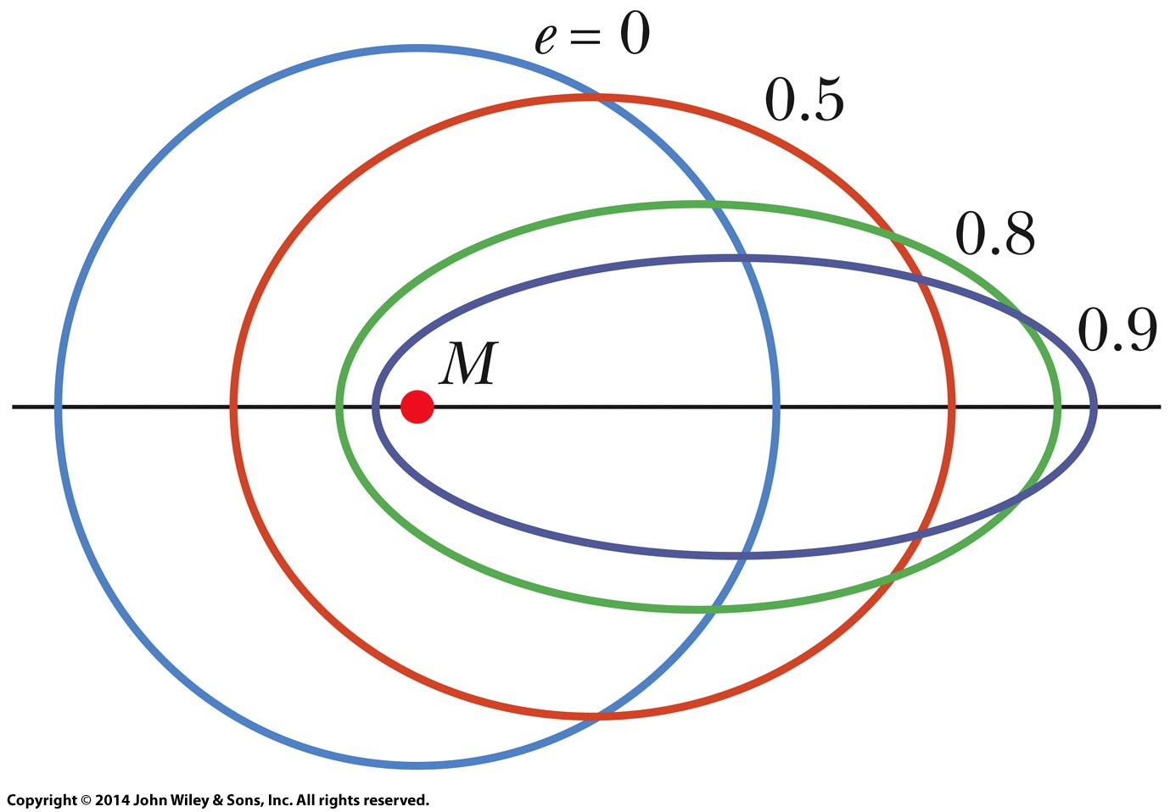
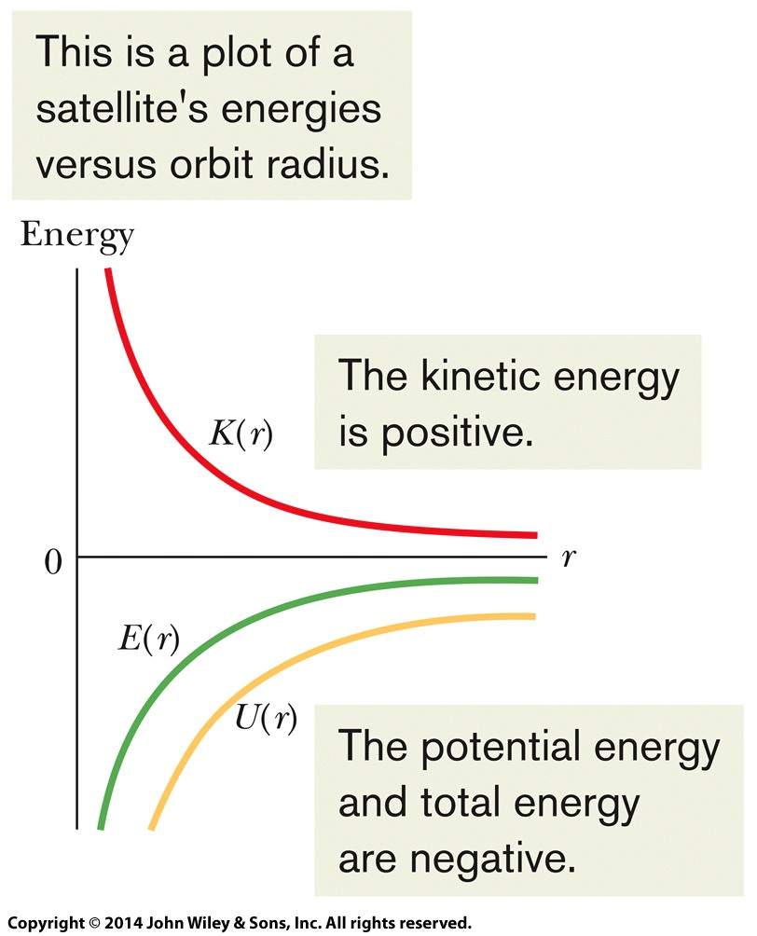
13-7 Satellites: Orbits and Energy
Total energy E is the negative of the kinetic energy
For an ellipse, we substitute a for r
Therefore the energy of an orbit depends only on its semimajor axis, not its eccentricity
All orbits in Figure 13-15 have the same energy
Figure 13-16
Figure 13-15
Notes:
33

Slide 34
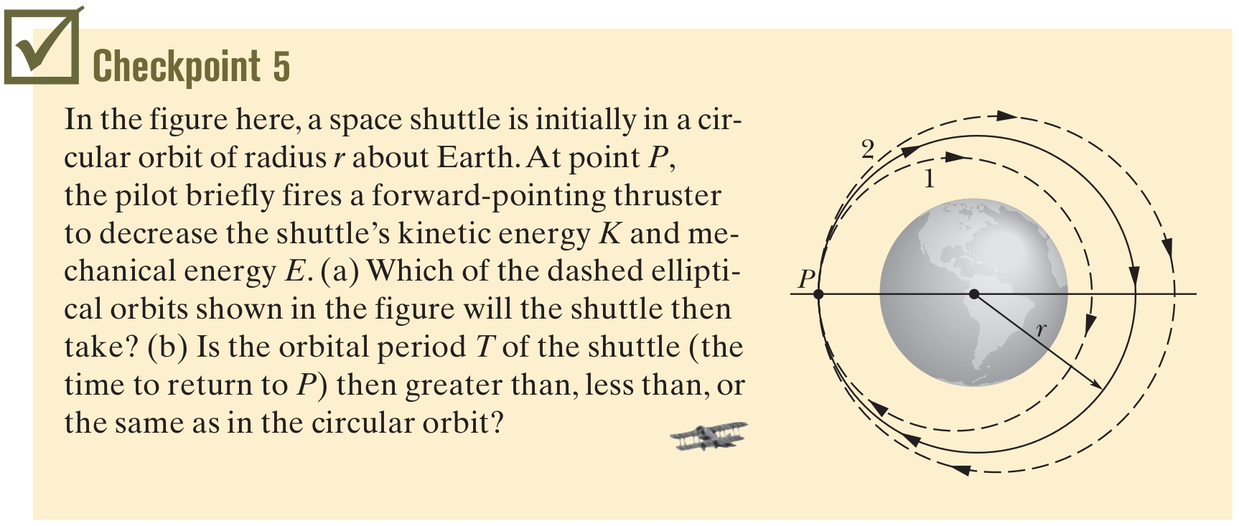
13-7 Satellites: Orbits and Energy
Answer: (a) orbit 1, since the energy has decreased (b) the semimajor axis has decreased, so the period decreases
Notes:
34

Slide 35
13-8 Einstein and Gravitation
Learning Objectives
13.24 Explain Einstein's principle of equivalence.
13.25 Identify Einstein's model for gravitation as being due to the curvature of spacetime.
Notes:
35

Slide 36
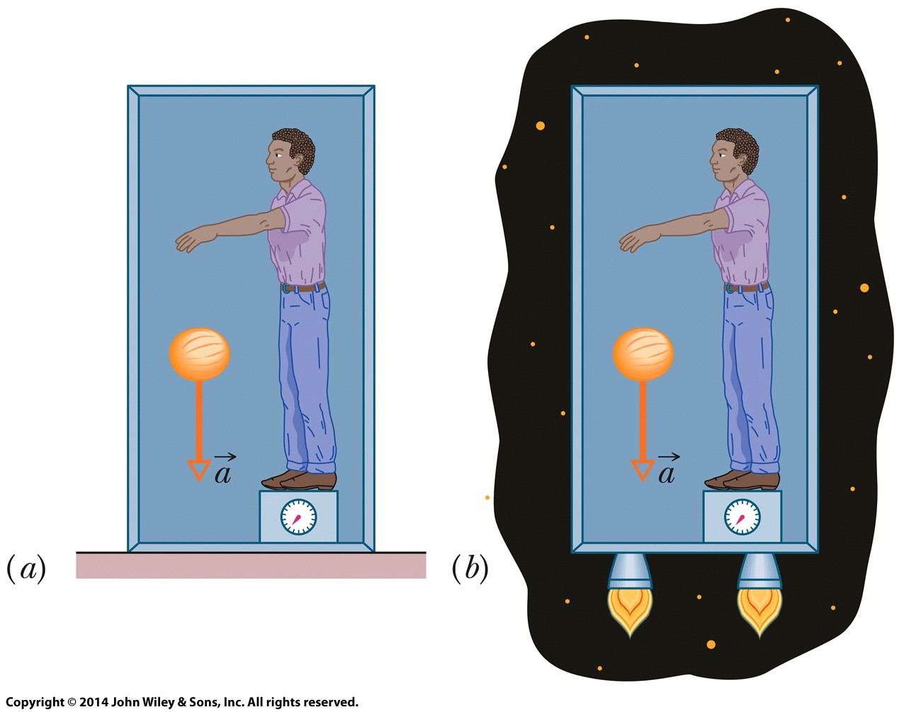
13-8 Einstein and Gravitation
The general theory of relativity describes gravitation
Its fundamental postulate is the principle of equivalence
Gravitation and acceleration are equivalent
The experimenter inside this box is unable to tell whether he is on Earth experiencing g = 9.8 m/s², or in free space accelerating at 9.8 m/s².
Figure 13-18
Notes:
36

Slide 37
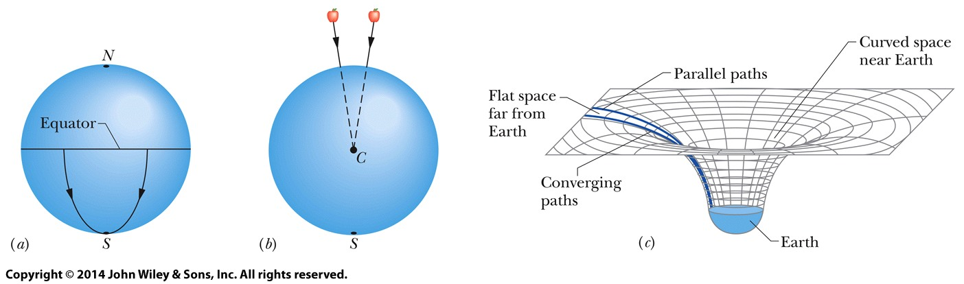
13-8 Einstein and Gravitation
Space (spacetime) is curved
Analogies: In (a) and (b), paths that appear to be parallel, along the surface of the Earth or falling toward the Earth's center, actually converge
We can see why by stepping “outside” the curved Earth, but we can't step “outside” of curved space
Figure 13-19
Notes:
37

Slide 38
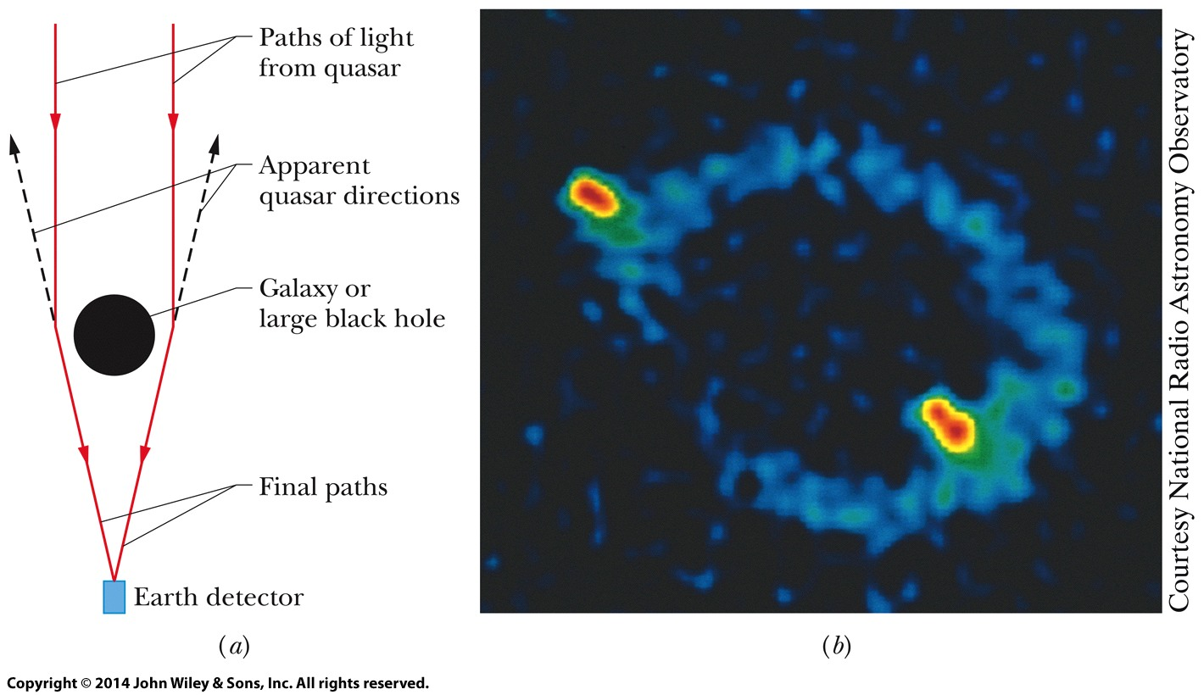
13-8 Einstein and Gravitation
But we can observe the curvature of space
Light bends as it passes by massive objects: an effect called gravitational lensing
In extreme cases we observe the light coming from multiple places, or bent into an Einstein ring
Figure 13-20
Notes:
38

Slide 39
13-8 Einstein and Gravitation
The source of gravitation, however, is still unclear
Is it purely an effect of curved spacetime?
Is it a force between masses?
Is it due to a fundamental particle, the graviton, which would carry the gravitational force?
These questions are not yet settled
Notes:
39

Slide 40
13 Summary
The Law of Gravitation
Gravitational Behavior of Uniform Spherical Shells
The net force on an external object: calculate as if all the mass were concentrated at the center of the shell
Eq. (13-1)
Eq. (13-2)
Superposition
Gravitational Acceleration
Eq. (13-5)
Eq. (13-11)
Notes:
40

Slide 41
13 Summary
Free-Fall Acceleration and Weight
Earth's mass is not uniformly distributed, the planet is not spherical, and it rotates: the calculated and measured values of acceleration differ
Gravitation within a Spherical Shell
A uniform shell exerts no net force on a particle inside
Inside a solid sphere:
Eq. (13-19)
Gravitational Potential Energy
Potential Energy of a System
Eq. (13-21)
Eq. (13-22)
Notes:
41

Slide 42
13 Summary
Escape Speed
Kepler's Laws
The law of orbits: ellipses
The law of areas: equal areas in equal times
The law of periods:
Eq. (13-28)
Eq. (13-34)
Energy in Planetary Motion
Kepler's Laws
Gravitation and acceleration are equivalent
General theory of relativity explains gravity in terms of curved space
Eq. (13-42)
Notes:
42

