Slide 1
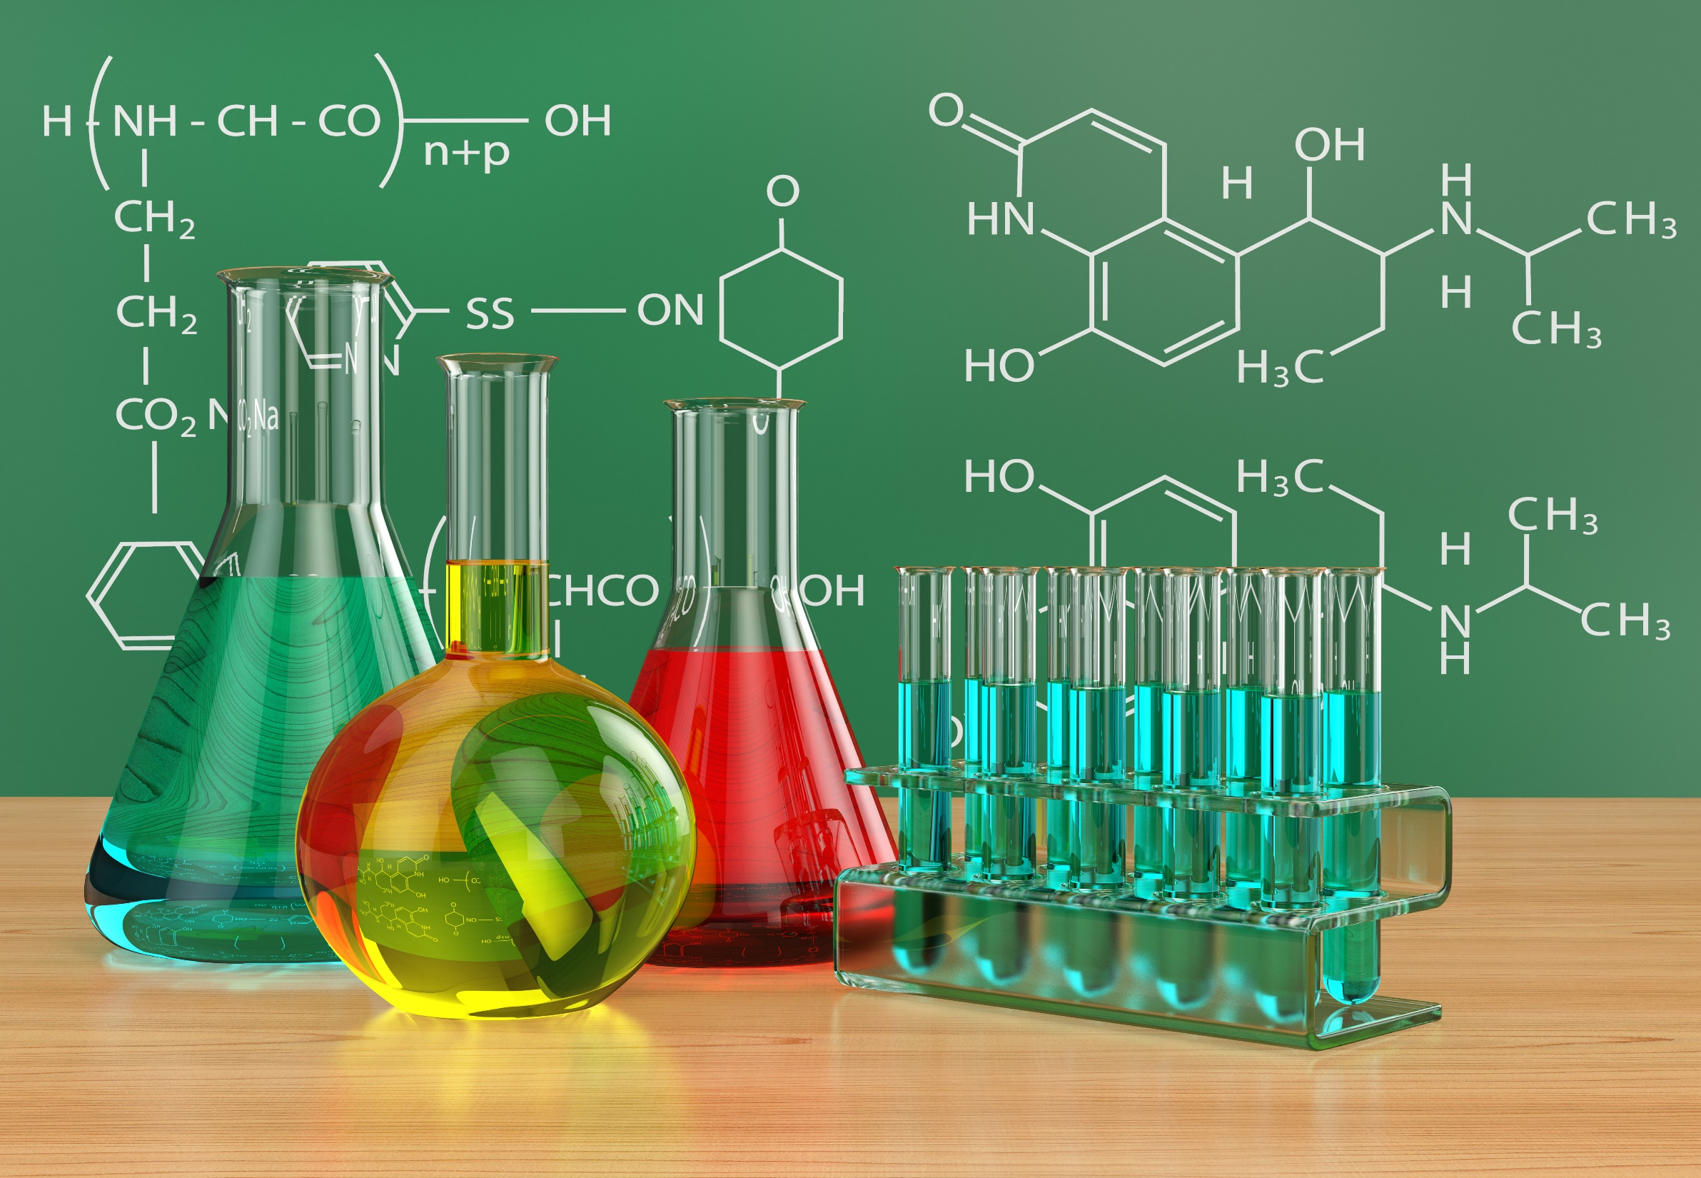
STUDY DIVISION A
THE BASIC BUILDING BLOCKS OF CHEMISTRY
Study Unit 1: (self study)
Basic concepts of Chemistry
Study Unit 2:
Atoms, molecules and ions
Study Unit 3:
Chemical reactions
Study Unit 4:
Stoichiometry: Quantitative information about Chemical reactions
Study Unit 5:
Principles of chemical reactivity: Energy and chemical reactions
Kotz, Treichel & Townsend, parts of chapters 1, 2, 3, 4 and 5
Study guide p. 1 - 49, Study Units 1, 2, 3, 4 & 5

Slide 2
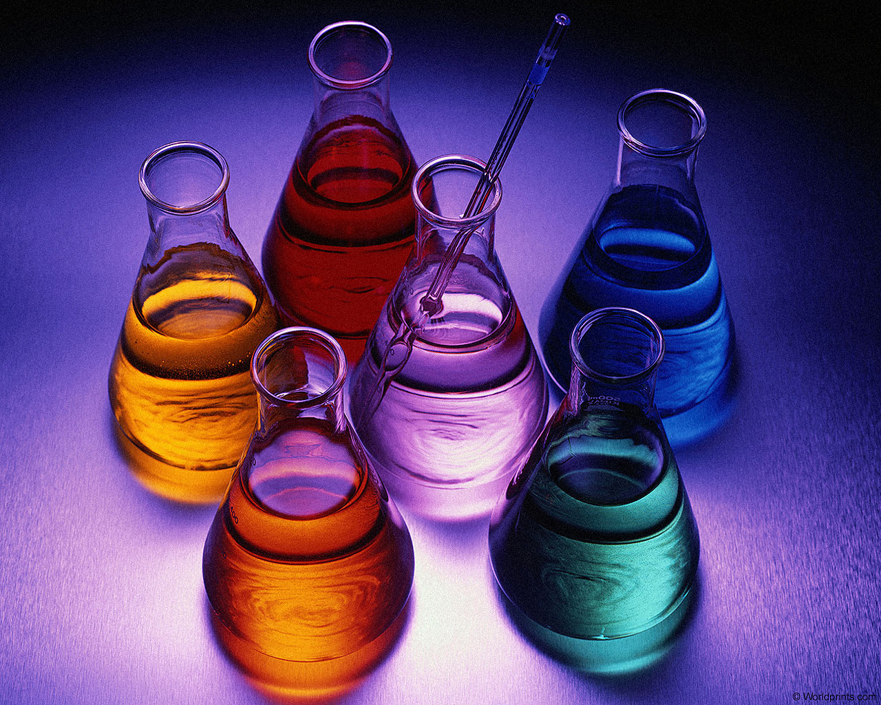
STUDY UNIT 2
ATOMS, MOLECULES AND IONS
KT & T, chapter 2
Study guide, Study Unit 2

Slide 3
STUDY SECTION
Atomic structure:
Protons, electrons and neutrons
2.1
This study section is based on chapter 2 of the textbook.
OUTCOMES
Following completion of this Study Section you should be able to:
Explain the terms electrons, protons, neutrons and general atomic structure; and
Explain the relative mass scale and atomic mass unit.

Slide 4
Dalton’s Atomic Theory (1808)
Elements are composed of extremely small particles called atoms. All atoms of a given element are identical. The atoms of one element are different from the atoms of all other elements.
Compounds are composed of atoms of more than one element. The relative number of atoms of each element in a given compound is always the same.
Chemical reactions only involve the rearrangement of atoms. Atoms are not created or destroyed in chemical reactions.

Slide 5
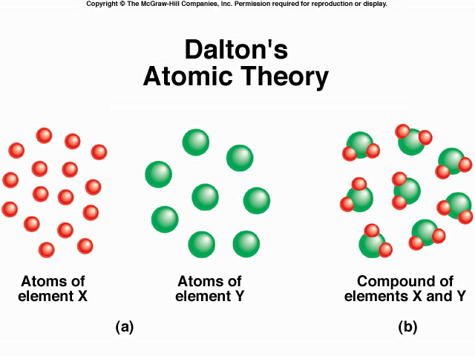
16 X
+
8 Y
8 X₂Y
Law of Conservation of Mass

Slide 6
Law of Conservation of Mass
The total mass of substances present at the end of a chemical process is the same as the mass of substances present before the process took place.

Slide 7
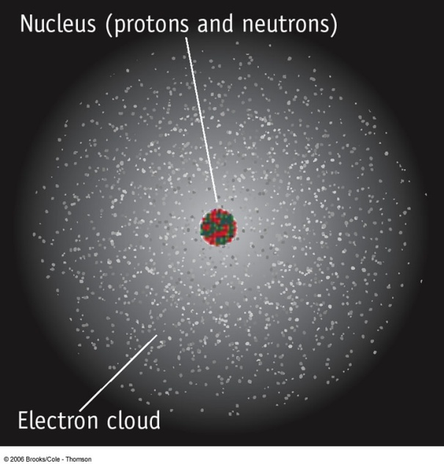
ATOM
COMPOSITION
The atom is mostly
empty space
the nucleus consists of protons and neutrons.
electrons in space around the nucleus.
the number of electrons equal the number of
protons.
atoms are extremely small. One teaspoon of water
has 3 times as many atoms as there are teaspoons
of water in the Atlantic Ocean.

Slide 8
ATOMIC COMPOSITION
Protons
positive (+) electrical charge; mass = 1.672622 x 10⁻²⁴ g
relative mass = 1.007 atomic mass units (amu) (of ame)
Electrons
negative (-) electrical charge; mass = 9.109382 x 10⁻²⁸ g
relative mass = 0.0005 amu (of ame)
Neutrons
no electrical charge; mass = 1.674927 x 10⁻²⁴ g
relative mass = 1.009 amu (of ame)

Slide 9
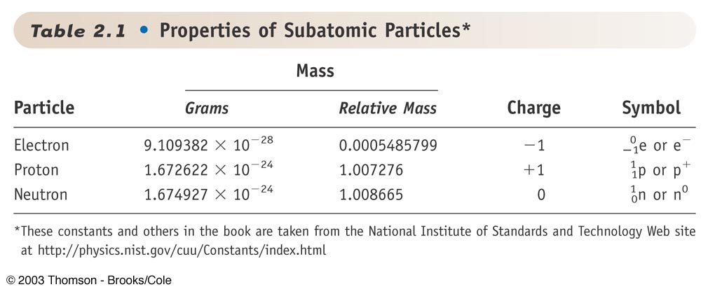
Because the mass of the proton and neutron are so close to 1 ame (Table above), the mass (relative mass) of the atom can be predicted if the number of protons and neutrons are known.
Mass number (A) = Sum total of the number of protons and neutrons
= number of protons + number of neutrons

Slide 10
Atomic Number, Z
All atoms of the same element have
the same number of protons in the
nucleus, Z

Slide 11
For the sodium atom with 11 protons and 12 neutrons in the nucleus – what is the the mass number of the atom?
Notation: ^{A}_{Z}X
Sodium
Notation: ^{A}_{Z}X
23
Na
11
Boor
p = red
n = green

Slide 12
TRY YOURSELF 2.1
Which one of the following atoms contains the largest number of protons?
¹²⁸Te; ¹²¹Sb; ¹²⁷I; ¹⁰⁷Ag; ¹¹²Cd

Slide 13
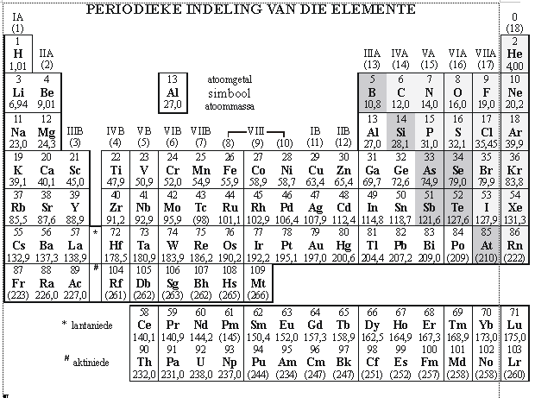
TRY YOURSELF 2.2
Give the mass number of
a nickel atom with 31 neutrons
a bismuth atom with 127 neutrons and
a tantalum atom with 110 neutrons.

Slide 14
Mass Number, A
Difference between:
Real Atomic mass
and
Relative Atomic mass

Slide 15
REAL ATOMIC MASS
(Exact Atomic Mass)
Is it possible to determine the real mass
(exact atomic mass) of an atom?
Which apparatus is used?
Mass Spectrometer

Slide 16
Relative Atomic mass
(Relative Mass)
What is the meaning of the word relative?
According to HAT:
Comparison between 2 units, thus one aspect with another aspect.

Slide 17
According to the mass spectrometer:
The real mass (exact mass) of a carbon atom is:
C = 1.9927 x 10⁻²⁶ kg
1C = 0.000000000000000000000000019927 kg
This number is to small to work with – use a reverance scale.
Compare

Slide 18
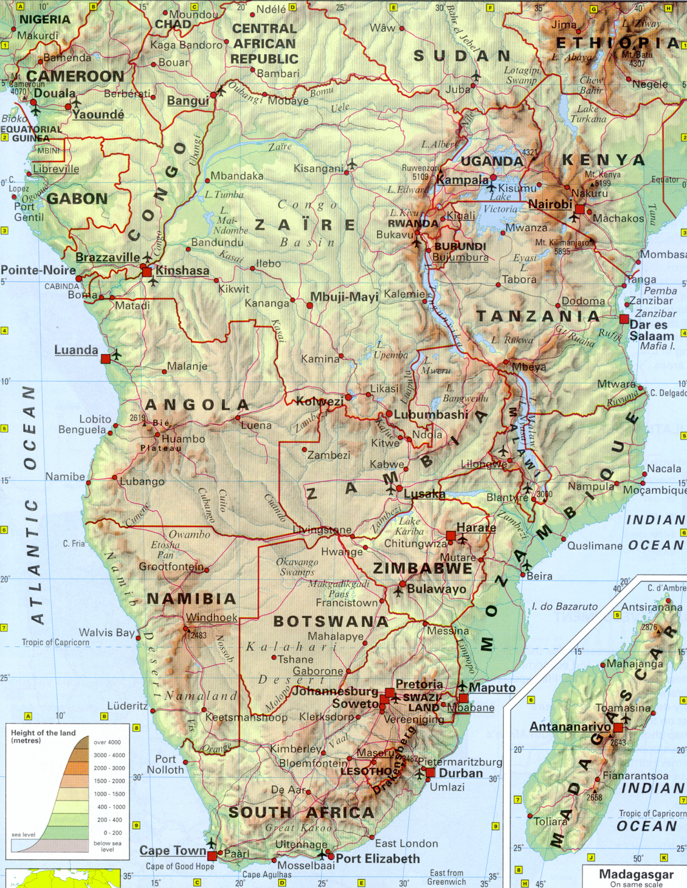
Scale:
100 km = 1 cm
Distance:
JBurg to Ctown = 1200 km
On map = 12 cm
Change large numbers to small numbers according to scale.
Relative distances

Slide 19
With an atoom?
Change small number to large number using a scale:
INTERNATIONAL comparison scale:
Allocate a value of 12 to a carbon atom:
1C = 12 amu (ame).
Thus: 12 amu is the relative atomic mass of carbon
The real mass (exact mass) of the carbon atom is: C = 1.9927 x 10⁻²⁶ kg
Therefore: 12 ame = 1.9927 x 10⁻²⁶ kg

Slide 20
 What is the relation between 1 amu and kg and g?
In other words, 1 amu is how much kg and g?
Given: 1C = 12 amu and 1C = 1.9927 x 10⁻²⁶ kg
1 ame ≡ 1.6606 x 10⁻²⁷ kg
I will supply you with this in
a test or exam.
1 ame ≡ 1.6606 x 10⁻²⁴ g
This is our comparison scale

Slide 21
TRY YOURSELF 2.3
 What is the massa of the He-atoom relative to the carbon atoom?
Given: He-atom = 6.6466 x 10⁻²⁷ kg (real mass)
(Mass in amu asked)
Scale: 1 ame = 1.6606 x 10⁻²⁷ kg

Slide 22
TRY YOURSELF 2.4
What is the mass in kg of an oxygen atom?
Given: Relative mass of O = 16 amu.
Scale: 1 ame ≡ 1.6606 x 10⁻²⁷ kg
Remember: Round all final answers off to 3 decimal points.

