Slide 1
STUDY SECTION
Atoms, molecules and the mole
2.7
This study section is based on chapter 2 of the textbook.
OUTCOMES
Following completion of this Study Section you should be able to:
Know and understand that the molar mass of an elements is the same as the mass in gram of Avogadro’s number of atoms in this element;
Know how to use the molar mass of an element and Avogadro number in calculations;
Know and understand that the molar mass of a compound is the mass in gram of Avogadro’s number of molecules of this compound;
Calculate the molar mass of a compound from the formula of the compound and the periodic table; and
Calculate the number of moles of a compound represented by a specific mass. You also have to be able to do the reverse.

Slide 2
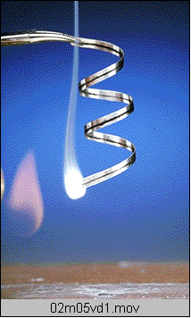
Counting Atoms
Mg burns in air (O₂) to produce white magnesium oxide, MgO.
Mg + O₂ MgO
2Mg + O₂ 2MgO
How can we figure out how much oxide is produced from a given mass of Mg?

Slide 3
Counting Atoms
Chemistry is a quantitative science
In reactions we want to know how much atoms and/or molecules reacted with each other, and how much atoms and/or molecules have formed as product.
We need a counting method or scale

Slide 4
The Mole: Basic Concepts
Measuring Matter
Chemists need a convenient method for counting accurately the number of atoms, molecules, or formula units in a sample of a substance.
As you know, atoms and molecules are extremely small. There are so many of them in even the smallest sample that it’s impossible to actually count them.
That’s why chemists created their own counting unit called the mole.

Slide 5
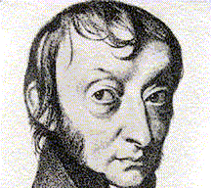
The Mole: Basic Concepts
The mole, commonly abbreviated mol, is the SI base unit used to measure the amount of a substance.
1 mole (mol) = 6.02 x 10²³ particles
“particles” may be atoms, molecules, or formula units
Compare: 12 = One dozen
The number 6.02 x 10²³ is called
Avogadro’s number
If you write out Avogadro’s number, it looks like this:
602 000 000 000 000 000 000 000

Slide 6
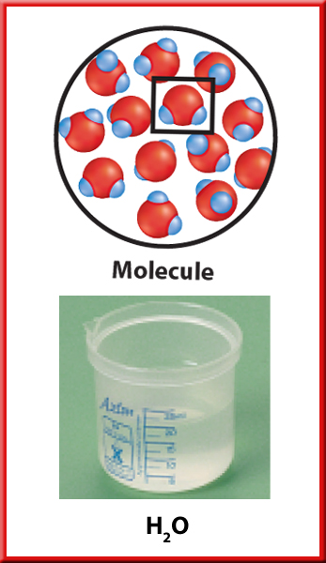
The representative particle in a mole of water is the water molecule.
1 mol H₂O = 6.02 x 10²³ H₂O molecules
602 000 000 000 000 000 000 000 H₂O molecules

Slide 7
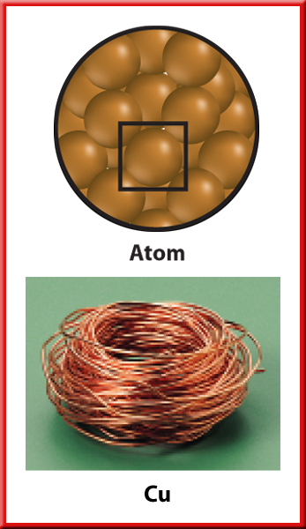
The representative particle in a mole of copper is the copper atom.
1 mol Cu = 6.02 x 10²³ Cu atoms
602 000 000 000 000 000 000 000 Cu atoms

Slide 8
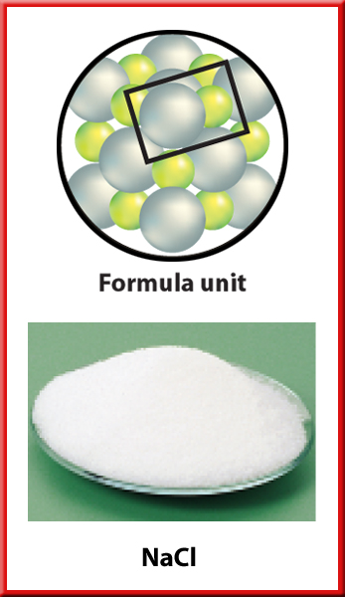
The representative particle in a mole of sodium chloride is the formula unit.
1 mol NaCl = 6.02 x 10²³ NaCl formula units
602 000 000 000 000 000 000 000 NaCl formula units
The term “formula unit” is used to
represent one “unit” of an ionic compound.

Slide 9
Example to try and illustrate the enormity of a mole amount.
HOW LONG WILL IT TAKE FOR THIEVES TO STEAL 1 MOLE OF RANDS IF THEY STEAL THE MONEY AT A RATE OF 1 MILLION RAND PER SECOND?
1 mole of rands = R 6.02 x 10²³
Per minute:
R1 000 000 x 60 = R60 000 000
Per hour:
R60 000 000 x 60 = R3 600 000 000 (R3.6 billion)
Per day:
R3 600 000 000 x 24 = R86 400 000 000 (R86.4 billion)
Per year:
R86 400 000 000 x 365 = R31 536 000 000 000 = only at R3.1536 x 10¹³ after 1 year
Number of years.. . .
R6.02 x 10²³ / R3.1536 x 10¹³ = 19 089 294 774 years!!!! More than 19 000 million years!!!!!

Slide 10

But there is still 1 mole (6.02 x 10²³) of water-molecules in only 18 mL (less than 4 tea spoons) of water!!!

Slide 11
Mole ← → Particle Conversions
Avagadro's number is used as a conversion factor to convert between # of moles and # of particles (atoms, molecules, ions, etc.)

Slide 12
Conversion of mol amount to number of particles….
Assume you want to determine the number of sucrose particles there are in 3.50 mole of sucrose. You know that 1 mole of sucrose contains 6.02 x 10²³ sucrose molecules.
Therefore, 3.50 mole of sucrose will contain 2.11 x 10²⁴ sucrose molecules because
3.50(6.02 x 10²³) = 2.11 x 10²⁴
2110000000000000000000000 molecules of sucrose
in 3.50 moles of sucrose

Slide 13
Conversion of the number of particles to the mole amount….
You will now just do the inverse.
You want to know how many moles are 2.11 x 10²⁴ of sucrose molecules.
Therefore, 2.11 x 10²⁴ molecules of sucrose will be equal to 3.50 mole of sucrose, because
2.11 x 10²⁴ / 6.02 x 10²³ = 3.50 mole

Slide 14
The Mass of a Mole (Molar mass)
Molar mass
Molar mass
The mass of one mole of a substance.
(unit for molar mass are g/mol OR g.mol⁻¹)

Slide 15
Counting Atoms
m_{1 mole of an atom/molecule} = real mass of the atom/molecule in gram x N_{A} (mol⁻¹)
Example
Calculate the mass of 1 mol of He-atoms.
Given: m_{He-atom} = 6.6466 x 10⁻²⁷ kg = 6.6466 x 10⁻²⁴ g
= 6.6466 x 10⁻²⁴ g x (6.022 x 10²³ mol⁻¹)
= 4.0026 g.mol⁻¹ ……(See the Periodic Table!)
= 4.0026 amu

Slide 16
Molar Mass = Relative Atomic mass
g.mol⁻¹ = amu

Slide 17
Deduction?
The relative atomic mass of the atom contains 1 mole atoms
There is Avogadro’s number of particles in a mole of any substance.

Slide 18
TRY YOURSELF 2.10
 How many sodium atoms are included in 0.023 kg of sodium?
(Given the real mass of one sodium atom is 3.819 x 10⁻²³ g)

Slide 19
TRY YOURSELF 2.11
What is the mass of one sulfur atom?
(Given: Molar mass of S = 32.1 g.mol⁻¹)

Slide 20
TRY YOURSELF 2.12
Calculate the mass, in grams, of 3.63 x 10⁻⁴ mole of Pu
Given: Pu = 244 g.mol⁻¹

Slide 21
TRY YOURSELF 2.13
The recommended daily allowance (RDA) of iron in your diet is 15 mg. How many moles is this? How many atoms?
Given: Fe = 55.9 g.mol⁻¹

Slide 22
TRY YOURSELF 2.14
An object is coated with a layer of chromium, 0.15 cm thick.
The object has a surface area of 15.3 cm². How many atoms of chromium are used in the coating?
(Density of chromium = 7.19 g.cm⁻³)
Cr = 52 g/mol

Slide 23
Mole and Mass
    n = m / M
Units!!!
    M = m / n
    Mole = n
    Mass = m
    Molar Mass = M
    n = m/M
    n = m / M
Mole amount (n) = Mass (m)
Molar mass (M)
= g / g.mol⁻¹
= mole
    n = m / M
    m = n x M

Slide 24
MOLAR MASS of compounds
Mass of 1 mole of a material in gram.
This material can be a compound or an element.
Molar mass of a compound, ex. H₂O
2H = 2 x 1.008 = 2.016 g
1O = 1 x 16.00 = 16.00 g
16.00 g + 2.016 g = 18.016 g
Molar mass of water (H₂O) = 18.016 g per mole
M_{H2O} = 18.016 g/mol

Slide 25
TRY YOURSELF 2.15
Calculate the molar mass of the following compounds:
HCl and Mg₃(PO₄)₂ and C₁₂H₂₂O₁₁

Slide 26
TRY YOURSELF 2.16
Calculate the number of moles of NaOH in 26.00 g of NaOH and also calculate the mass, in grams, of 0.02 moles of NaOH.

Slide 27
TRY YOURSELF 2.17
Sulfur trioxide, SO₃, is made industrially in enormous quantities by combining oxygen and sulfur dioxide, SO₂.
1. How many moles of SO₃ is represented by 1.00 kg of SO₃?
2. How many molecules of SO₃ are in 1.00 kg of SO₃?
3. How many sulfur atoms are in 1.00 kg of SO₃?
4. How many oxygen atoms are in 1.00 kg of SO₃?

