Slide 1
STUDY SECTION
isotopes
2.2
This study section is based on chapter 2 of the textbook.
OUTCOMES
Following completion of this Study Section you should be able to:
Define isotopes and write down the mass number as well as the number of neutrons for a specific isotope; and
Do simple calculations to link the atomic mass of an element and the isotope abundance with each other.

Slide 2
Boron-10 (¹⁰B) has 5 p and 5 n
Boron-11 (¹¹B) has 5 p and 6 n
¹¹B
p = rooi
n = groen
¹⁰B
ISOTOPES
Atoms of the same element (same Z) but different mass number (A). Different with regard to the number of neutrons.

Slide 3
Generally we refer to a particular isotope by giving its mass number, for example, uranium-238 or ²³⁸U

Slide 4
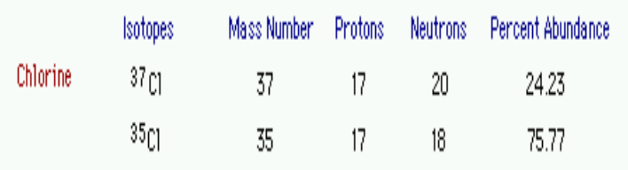
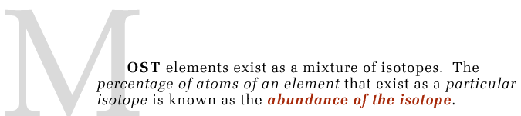
You must be able to explain the term isotope abundance with an example.

Slide 5
STUDY SECTION
The periodic table – self study
2.3
This study section is based on chapter 2 of the textbook.
OUTCOMES
Following completion of this Study Section you should be able to:
Identify groups and periods on the periodic table; and
Distinguish between the metals, metalloids, non-metals, alkaline metals, alkaline earth metals, halogens, noble gasses and the transition metals on the periodic table.

Slide 6
STUDY SECTION
Molecules, compounds and formulae
2.4
This study section is based on chapter 2 of the textbook.
OUTCOMES
Following completion of this Study Section you should be able to:
Recognize and interpret molecular formulae, abbreviated formulae and structural formulae; and
Know of the different molecular models that exist in chemistry.

Slide 7
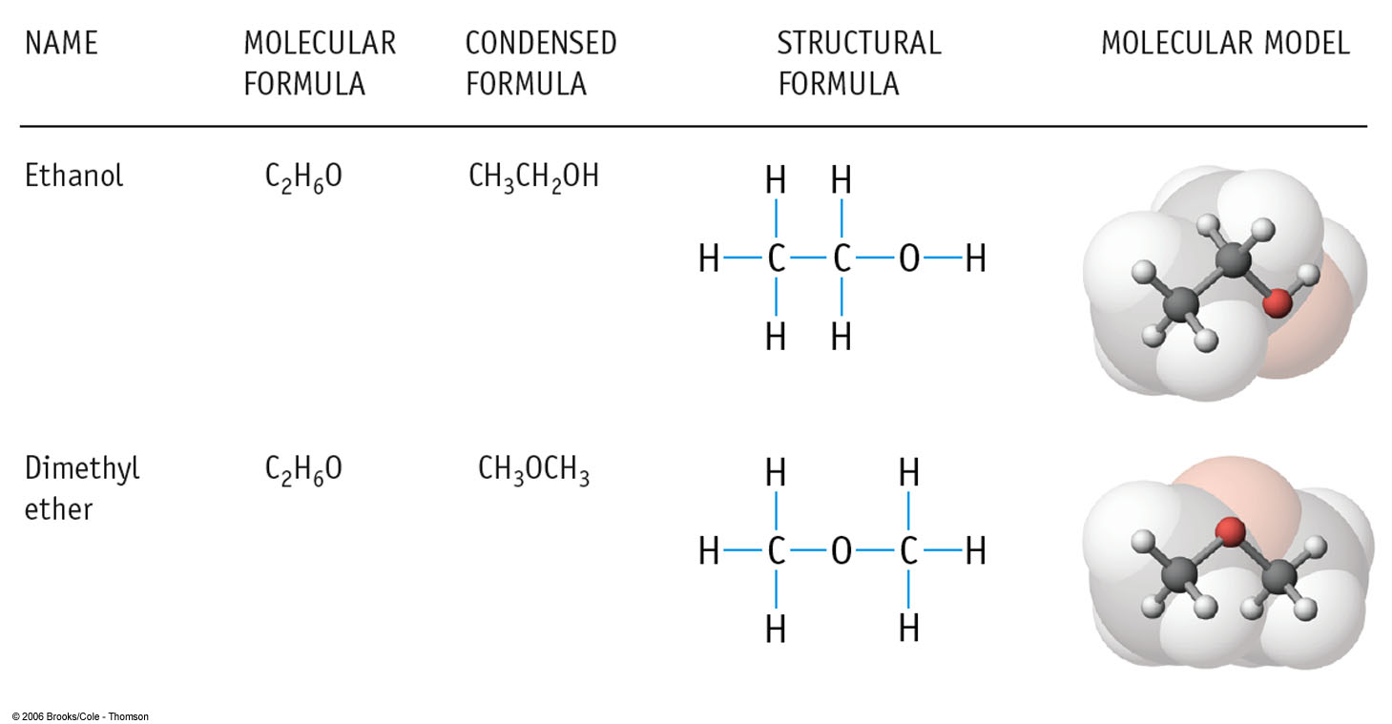
Molecular formula: Atom symbols with subscripts
Indicating number of atoms of element present.
Condensed formula: Groups atoms bonded to one another.
(CH₃CH₂OH, 1C bonded to 3H, 2nd C bonded to 2H, O bonded to 1H).
Structural formula: Shows bonds between atoms as lines.

