Slide 1
STUDY SECTION
Ionic compounds:
Formulae, names and characteristics
2.5
This study section is based on chapter 2 of the textbook.
OUTCOMES
Following completion of this Study Section you should be able to:
Know that metals usually lose one or more electrons in order to form positive ions – called cations – and that non-metals usually take up one or more electrons to form negative ions – called anions;
Predict the change on a metal cation for the following groups of metals: Groups 1A, 2A and 3A;
Predict the charge on a non-metal anion for the following groups of non-metals: Groups 4A, 5A, 6A and 7A;
Write down formulae for ionic compounds through combining cations and anions in the correct ratio so that there is no total charge for the ionic compound;
Know the names and formulae of poly-atomic cations and anions;
Name ionic compounds and simple binary compounds of the non-metals; and
Know Coulomb’s Law and understand the importance of this law.

Slide 2
Atom loses electron(s) ⇒ cation (+)
(metals)
Atom gets (takes up) electron(s) ⇒ anion (-)
(non-metals)
Noble gasses does not readily take up or lose e⁻ (chemically inert)

Slide 3
METALS
Metal → Metal^{n+} + ne⁻
where n = periodic group
Na⁺ sodium ion
Mg²⁺ magnesium ion
Al³⁺ aluminum ion
Transition metals → M²⁺ or M³⁺ are common
Fe²⁺ iron(II) ion
Fe³⁺ iron(III) ion
See back of study guide

Slide 4
NONMETALS
NONMETAL(X) + ne- → X^{n-}
where n = 8 - Group no
Group 4A
Group 5A
Group 6A
Group 7A
C⁴⁻,carbide
N³⁻, nitride
O²⁻, oxide
F⁻, fluoride
S²⁻, sulfide
Cl⁻, chloride
Br⁻, bromide
I⁻, iodide

Slide 5
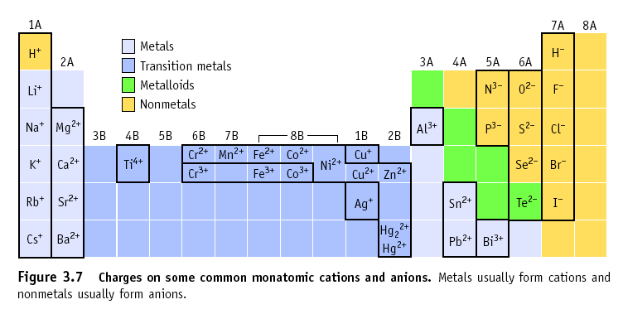
Predicting Charges on Monatomic Ions
H can take up or lose an e⁻ !

Slide 6
Formation of ions

Slide 7
Explain ion formation for manganese (₂₅Mn)- and iron atoms (₂₆Fe) in terms of charge and the change in the number of protons and electrons.
Example
₂₅Mn (25p⁺, 25e⁻) - 2e⁻ →
₂₅Mn²⁺ (25p⁺, 23e⁻)
₂₆Fe (26p⁺, 26e⁻) - 2e⁻ →
₂₆Fe²⁺ (26p⁺, 24e⁻)
₂₆Fe (26p⁺, 26e⁻) - 3e⁻ →
₂₆Fe³⁺ (26p⁺, 23e⁻)

Slide 8
POLYATOMIC IONS
Groups of atoms with a charge.
Atoms are bonded by Covalent Bonding
Example: SO₄²⁻
Sulfate (sulphate) - ion

Slide 9
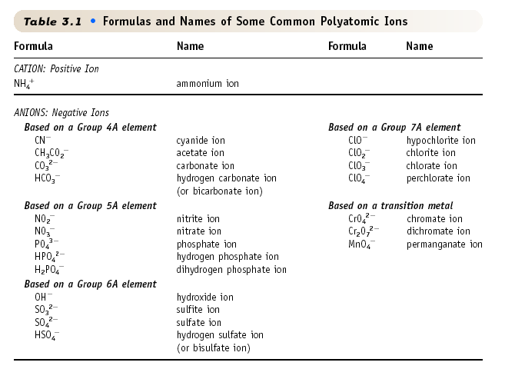
Table 2.4

Slide 10
FORMULAS FOR IONIC COMPOUNDS

Slide 11
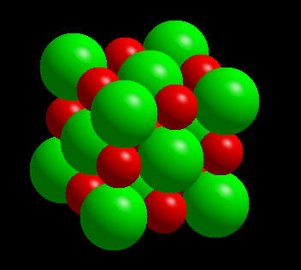
COMPOUNDS FORMED FROM IONS
CATION + ANION → ionic compound
The compound that forms must be neutral!!!!!
No charge
[+1 + (-1) = 0]
Na⁺ + Cl⁻ → NaCl

Slide 12
A neutral compound requires equal
numbers of + and - charges.
Ca²⁺ + 2F⁻ → CaF₂
Calcium fluoride
Mg²⁺ + 2NO₃⁻ → Mg(NO₃)₂ Magnesium nitrate
3Fe²⁺ + 2PO₄³⁻ → Fe₃(PO₄)₂ Iron(II) phosphate

Slide 13
NAMING OF THE POSITIVE IONS- CATIONS
(i) For monatomic positive ion: the name of the metal cation plus the word ion. Ex. Al³⁺ = aluminium ion
In some cases, primarily for the transition metals where the metal atom can form more than one type of ion, charge is indicated by the Roman number in brackets after the name of the ion.
Ex. Ti²⁺ - titanium(II), Ti⁴⁺ - titanium(IV) etc.

Slide 14
NAMING OF THE POSITIVE IONS- CATIONS
Remember that the name of the positive poli- atomic ion, NH₄⁺, is the ammonium ion.
It must not be confused with NH₃ which is the ammoniac molecule.

Slide 15
NAMING OF THE NEGATIVE IONS: ANIONS
Two types: Mono-atomic negative ions and poli-atomic negative ions.
Mono-atomic anions
A mono-atomic negative ion is named by adding the suffix, -ide after the name of the non metal.
The group 7 elements (the halogens) are named the halides.

Slide 16
Second type
NAMING OF POLI-ATOMIC NEGATIVE IONS
Oxo-anions
Ion with larger number of O-ions gets the suffix –ate.
Ion with smaller number of O-ions gets the suffix –ite.
NO₃⁻ nitrate en NO₂⁻ nitrite
In oxo anions that forms a series, the ion with the largest number of O-atoms gets the prefix per- and the suffix –ate
The ion with the smalles number of O-atoms gets the prefix hypo- and the suffix –ite.
ClO₄⁻ perchlorate; ClO₃⁻ chlorate ClO₂⁻ chlorite; ClO⁻ hypochlorite

Slide 17
Oxo anions that contains hydrogen, are named by the prefix hydrogen, followed by the name of the oxo-anion.
If two hydrogen atoms are present, then the prefix dihydrogen is used.
Ex. HCO₃⁻ Hydrogen carbonate ion
HSO₄⁻ Hydrogen sulfate (sulphate) ion H₂PO₄⁻ Dihydrogen phosfate (phosphate) ion

Slide 18
TRY YOURSELF 2.5
Write formulas for all the ionic compounds that can be formed by combining the following ions:
NH₄⁺ and Ni²⁺ with CO₃²⁻ and PO₄³⁻

Slide 19
TRY YOURSELF 2.6
Which compound formula and name in the list is NOT correct?
1. CaSO₄, calcium sulfate 2. NaNO₃, sodium nitrate 3. MgI₂, magnesium iodide 4. NH₄PO₄, ammonium phosphate 5. Ca(ClO)₂, calcium hypochlorite

Slide 20
TRY YOURSELF 2.7
Sodium oxalate has the formula Na₂C₂O₄. Based on this information, what is the formula for iron(III) oxalate?
1. FeC₂O₄ 2. Fe(C₂O₄)₂ 3. Fe(C₂O₄)₃
4. Fe₂(C₂O₄)₃ 5. Fe₃(C₂O₄)₂

Slide 21
TRY YOURSELF 2.8
Which of the following are correct formulas for compounds?
For those that are not, give the correct formula.
a) AlCl b) NaF₂ c) Ga₂O₃ d) MgS
e) CaO f) SrCl₂ g) Fe₂O₃ / FeO h) K₂O

Slide 22
Properties of Ionic Compounds
You must be able to deduct the properties of ionic compounds by using ‘Coulombs law’.

Slide 23
MgO and NaCl are both ionic compounds, but MgO has a melting point of 2800ºC and NaCl a melting point of 801ºC
Why the difference in melting points between MgO and NaCl?
Because of difference in strength of bonding between ions

Slide 24
Forming NaCl from Na and Cl₂
A metal atom can transfer an electron to a nonmetal.
The resulting cation and anion are attracted to each other by ‘electrostatic forces’.

Slide 25
Electrostatic Forces
The oppositely charged ions in ionic compounds are attracted to one another by ELECTROSTATIC FORCES.
These forces are governed by COULOMB’S LAW.

Slide 26
Electrostatic Forces
COULOMB’S LAW
(charge on +)(charge on -)
Force of attraction =
(distance between ions)²
As ion charge increases, the attractive force _______________.
As the distance between ions increases, the attractive force ________________.
increase
decrease

Slide 28
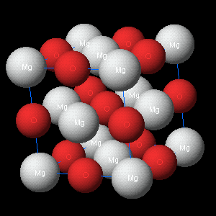
Application of Coulomb's law
Explain why the melting point of MgO (2801 ºC) is much higher than the melting point of NaCl (801 ºC)
NaCl: Na⁺ and Cl⁻
(m.p. 801 ºC)
MgO: Mg²⁺ and O²⁻
(m.p. 2801 ºC)

Slide 29
ANSWER
According to Coulomb's law:
The attraction forces between ions is directly proportional to the product of the ion charges
The force of attraction between Mg²⁺ and O²⁻ ions in MgO is approximately four times greater than the force of attraction between Na⁺ and Cl⁻ ions in NaCl
So, a much higher temperature is required to disrupt the orderly array of ions in crystalline MgO

Slide 30
TRY YOURSELF 2.9
Which one of the following two ionic compounds melting point will be higher? Explain your answer.
NaCl and RbI

Slide 31
STUDY SECTION
Molecular compounds:
Formulaes and names
2.6
This study section is based on chapter 2 of the textbook.
OUTCOMES
Following completion of this Study Section you should be able to:
Name simple binary compounds of the non-metals.

Slide 32
MOLECULAR COMPOUNDS
Can be:
Gasses, liquids and solids at room temperature
Molecular Compounds - Compounds without Ions
CO₂

