Slide 1
STUDY SECTION
3.3
Aqueous solutions
This study section is based on chapter 3 in the textbook.
OUTCOMES
Following completion of this Study Section you should be able to:
Recognize the differences between electrolytes and non-electrolytes as well as an example of each type;
Predict the solubility of ionic compounds in water by making use of a solubility table. (Although the table in the middle of p. 108 of KT&T will be supplied to you in tests and the examination you have to make very sure that you know how to use the table. The table is also provided at the back of the Study Guide; and
Name the ions that form when an ionic compound of an acid or a base dissolves in water.

Slide 2
Waterige oplossings (Aqueous solutions)
Many reactions in chemistry and almost all of the reactions that occur in living things are carried out in solutions in which the reacting substances are dissolved in water.
We define a solution as a homogeneous mixture of 2 or more substances.
One substance is the solvent (oplosmiddel), the medium in which another substance – the solute (die opgeloste stof) – is dissolved.
Aqueous solutions are solutions in which water is the solvent.

Slide 3
Why must reagents rather be in liquid form or in the gas phase?
For a chemical reaction reagent molecules or ions need to make contact.
Reactions between two solids usually proceed at a very slow rate.
The atoms, molecules or ions in fixed positions have very little opportunity to get together.
The majority of chemical reactions is therefore done in liquid solutions or in the gas phase.

Slide 4
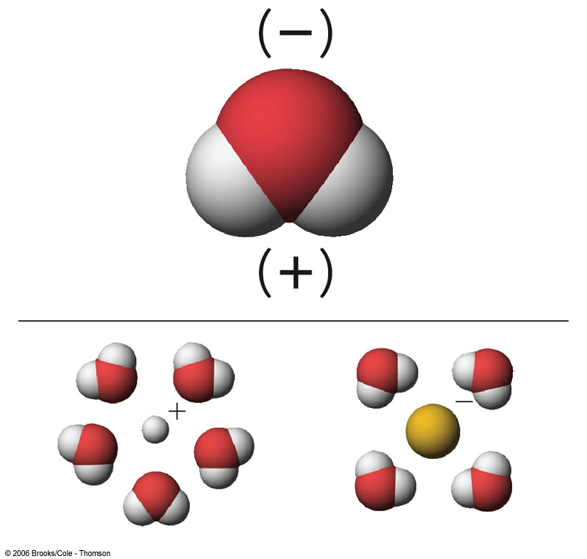
IONS IN AQUEOUS SOLUTION
Dissolving an ionic solid requires separating each ion from the oppositely charged ions that surround it in the solid state.
Water is good at dissolving ionic compounds because each water molecule has a positively charged end and a negativily charged end.

Slide 5
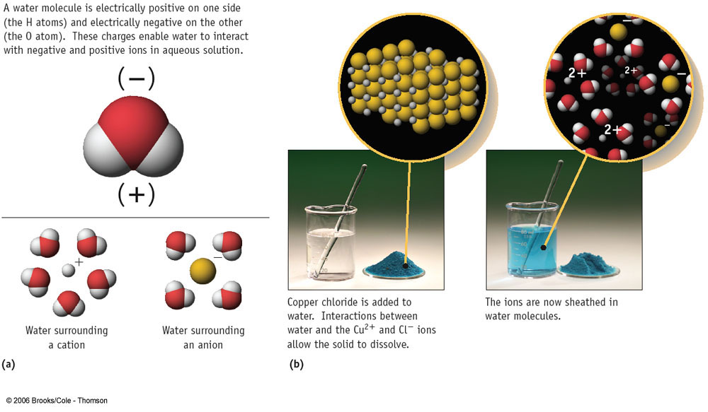
IONS IN AQUEOUS SOLUTION

Slide 6
IONS IN AQUEOUS SOLUTION
How do we know that ions are present in aqueous solution?
The solutions conduct electricity!
They are called ELECTROLYTES.

Slide 7
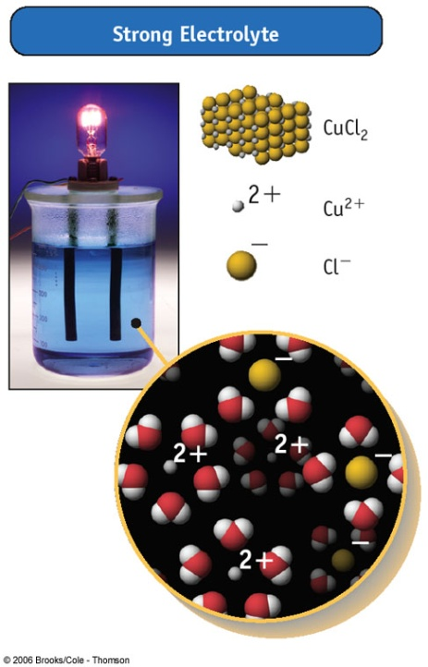
STRONG ELECTROLITES
Good conductors of electricity are strong electrolytes.
Ex. HCl, MgCl₂, NaCl.
They dissociate completely (or nearly so) into ions.

Slide 8
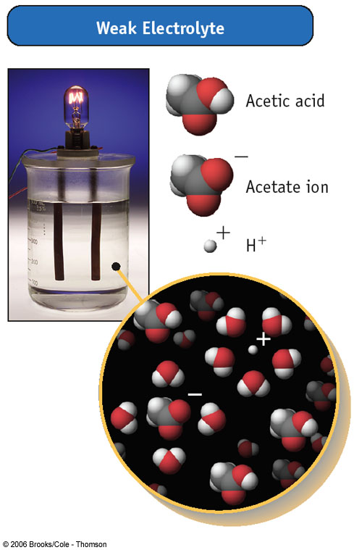
WEAK ELECTROLITES
Acetic acid ionizes or dissociate only to a small extent, so it is a weak electrolyte
CH₃CO₂H(aq) → CH₃CO₂⁻(aq) + H⁺(aq)

Slide 9
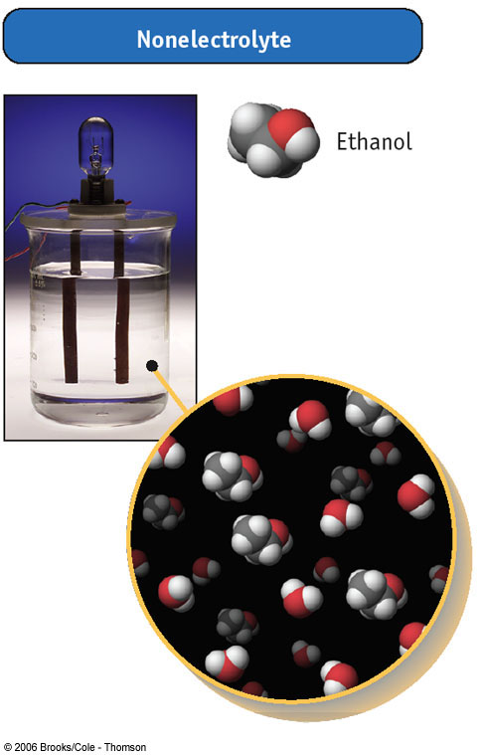
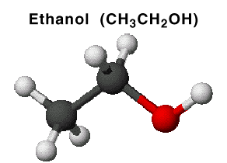
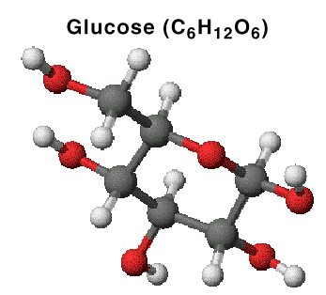
NON-ELECTROLITES
Some compounds dissolve in water but do not ionize and therefore do not conduct electricity. They are called non-electrolytes.
  Examples include:
  sugar
  ethanol
  ethylene glycol (in antifreeze)

Slide 10
Solubility of ionic compounds in water
Not all ionic compounds dissolve in water. Some are INSOLUBLE.
Look at solubility rules:

Slide 11
Solubility Table
Soluble compounds
Almost all salts of Na⁺, K⁺, NH₄⁺ | Almost all salts of Cl⁻, Br⁻, I⁻ | Salts containing F⁻ | Salts of sulfate, SO₄²⁻
Salts of nitrates, NO₃⁻ Salts of chlorate, ClO₃⁻ Salts of perchlorate, ClO₄⁻ Salts of acetate, CH₃CO₂⁻
NO EXCEPTIONS | Exceptions (not soluble) | Exceptions (not soluble) | Exceptions (not soluble)
 | Halides of Ag⁺, Hg₂²⁺, Pb²⁺ | Fluorides of Mg²⁺, Ca²⁺, Sr²⁺, Ba²⁺, Pb²⁺ | Sulfates of Ca²⁺, Sr²⁺, Ba²⁺, Pb²⁺, Ag⁺
Insoluble compounds
Salts of carbonate, CO₃²⁻ Salts of phosphate, PO₄³⁻ Salts of oxalate, C₂O₄²⁻ (CO₂)₂²⁻ Salts of chromate, CrO₄²⁻ Salts of sulphide, S²⁻ | Most metal hydroxides and oxides
Exceptions (soluble) | Exceptions (soluble)
Salts of NH₄⁺ and the alkali metal cations, and BaS | Alkali metal hydroxides and Ba(OH)₂ and Sr(OH)₂

Slide 12
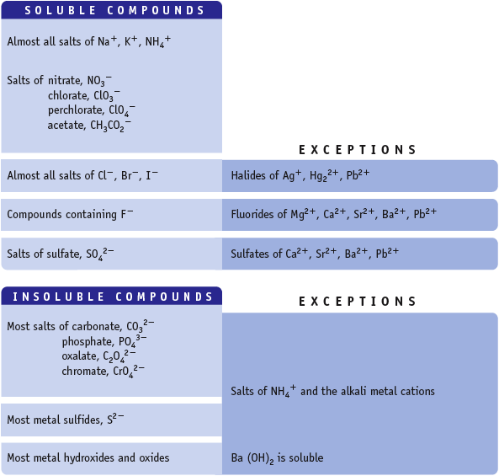
Water Solubility of Ionic Compounds
If one ion from the “Soluble Compd.” list is present in a compound, the compound is water soluble.

Slide 13
Try Yourself 3.4
Which one of the compounds listed below is water soluble?
a) CuS
b) Fe₃(PO₄)₂
c) Ba(NO₃)₂
d) Mg(OH)₂
Calsium nitrate dihydrate is dissolved in water. What ions are present in solution?
a) Ca²⁺ and (NO₃)²⁻
b) Ca²⁺ and 2NO₃⁻
c) Ca and 2NO₃
d) Ca⁺ and NO₃⁻

Slide 14
Try Yourself 3.5
Predict if each of the following ionic compounds are water soluble or not. If it is water soluble, write down the formulas of the ions in solution.
a) LiNO₃ b) CaCl₂ c) Cu(OH)₂ d) NaCH₃CO₂

