Slide 1
STUDY SECTION
3.4
Precipitation reactions
This study section is based on chapter 3 in the textbook.
OUTCOMES
Following completion of this Study Section you should:
Be able to predict the products of a precipitation reaction;
Write down a balanced equation for a precipitation reaction; and
Write net ionic equations.

Slide 2
PRECIPITATION REACTIONS
During precipitation reactions a precipitate is formed as an insoluble product.
In general both the reagents and the products are ionic compounds.
Precipitation reactions are possible because there are many positive and negative ion combinations that can give insoluble products.

Slide 3
PRECIPITATION REACTIONS..
Precipitation reactions are examples of exchange reactions (sometimes called double displacement) in which the ions of the reactants change partners.
A⁺ B⁻ + C⁺ D⁻ → A⁺ D⁻ + C⁺ B⁻
Water-insoluble solid
product (presipitate)
AgNO₃(aq) + KCl(aq) → AgCl(s) + KNO₃(aq)
Ag+NO₃⁻(aq) + K⁺Cl⁻(aq) → Ag⁺Cl⁻(s) + K⁺NO₃⁻(aq)

Slide 4
Mixing aqueous solutions of silver nitrate and potassium chloride produces white, insoluble silver chloride, AgCl.

Slide 5
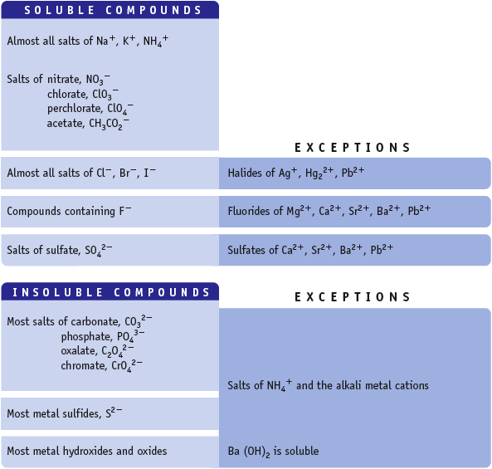
Guidelines for predicting Solubility

Slide 6
Solubility Table
Soluble compounds
Almost all salts of Na⁺, K⁺, NH₄⁺ | Almost all salts of Cl⁻, Br⁻, I⁻ | Salts containing F⁻ | Salts of sulfate, SO₄²⁻
Salts of nitrates, NO₃⁻ Salts of chlorate, ClO₃⁻ Salts of perchlorate, ClO₄⁻ Salts of acetate, CH₃CO₂⁻
NO EXCEPTIONS | Exceptions (not soluble) | Exceptions (not soluble) | Exceptions (not soluble)
 | Halides of Ag⁺, Hg₂²⁺, Pb²⁺ | Fluorides of Mg²⁺, Ca²⁺, Sr²⁺, Ba²⁺, Pb²⁺ | Sulfates of Ca²⁺, Sr²⁺, Ba²⁺, Pb²⁺, Ag⁺
Insoluble compounds
Salts of carbonate, CO₃²⁻ Salts of phosphate, PO₄³⁻ Salts of oxalate, C₂O₄²⁻ (CO₂)₂²⁻ Salts of chromate, CrO₄²⁻ Salts of sulphide, S²⁻ | Most metal hydroxides and oxides
Exceptions (soluble) | Exceptions (soluble)
Salts of NH₄⁺ and the alkali metal cations, and BaS | Alkali metal hydroxides and Ba(OH)₂ and Sr(OH)₂

Slide 7
Pb(NO₃)₂ and (NH₄)₂S produce black, insoluble PbS
FeCl₃ and NaOH produce orange, insoluble Fe(OH)₃
AgNO₃ and K₂CrO₄ produce orange, insoluble Ag₂CrO₄
Pb(NO₃)₂ and K₂CrO₄
produce yellow,
insoluble PbCrO₄

Slide 8
Try Yourself 3.6
Predict the products of each precipitation reaction and then balance the complete equation
Lead(II)nitrate(aq) + Potassium bromide(aq) → ?
Calcium nitrate(aq) + Potassium fluoride(aq) → ?
Sodium carbonate(aq) + Copper(II) chloride(aq) → ?
Nickel(II) chloride(aq) + Potassium hydroxide(aq) → ?

Slide 9
Nett Ionic equations
Sometimes it is nessessary to write a reaction in aqueous solution in its simplest form.
This is the so called “netto ionic equation”
Spectator ions are left out of the equation.

Slide 10
Example
Write balanced net ionic equations for the following reaction:
AlCl₃ + Na₃PO₄ → AlPO₄ + NaCl
1) Write complete balanced equation with physical states.
AlCl₃ (aq) + Na₃PO₄ (aq) → AlPO₄ (s) + 3NaCl (aq)
2) Write all soluble reagents and products as ions.
Al³⁺(aq) + 3Cl⁻(aq) + 3Na⁺(aq) + PO₄³⁻(aq) → AlPO₄(s) + 3Na⁺ + 3Cl⁻
3) Eliminate spectator ions.
Al³⁺(aq) + 3Cl⁻(aq) + 3Na⁺(aq) + PO₄³⁻(aq) → AlPO₄(s) + 3Na⁺(aq)+ 3Cl⁻(aq)
4) Write balanced nett ionic equation.
Al³⁺(aq) + PO₄³⁻(aq) → AlPO₄(s)

Slide 11
Try Yourself 3.7
Write a balanced net ionic equation for the following reaction:
Aqueous solutions of calcium chloride and sodium phosphate are mixed.

Slide 12
STUDY SECTION
3.5
Acids and bases
Only take note of this unit on p. 114-123. We will do a full investigation into Acids and bases in Study Unit 8.

Slide 13
STUDY SECTION
3.6
Gas formation reactions
This study section is based on chapter 3 in the textbook.
OUTCOMES
Following completion of this Study Section you should:
Be able to predict the products of a gas formation reaction; and
Write down a balanced equation for a gas formation reaction.

Slide 14
Recognizing Gas-Forming Reactions
All metal carbonates and bicarbonates react with acids to produce carbonic acid, H₂CO₃, which rapidly decomposes to CO₂ and H₂O.
CaCO₃(s) + 2HCl(aq) → CaCl₂(aq) + H₂CO₃(aq)
H₂CO₃(aq) → H₂O(l) + CO₂(g)
Overall reaction:
CaCO₃(s) + 2HCl(aq) → CaCl₂(aq) + H₂O(l) + CO₂(g)

Slide 15
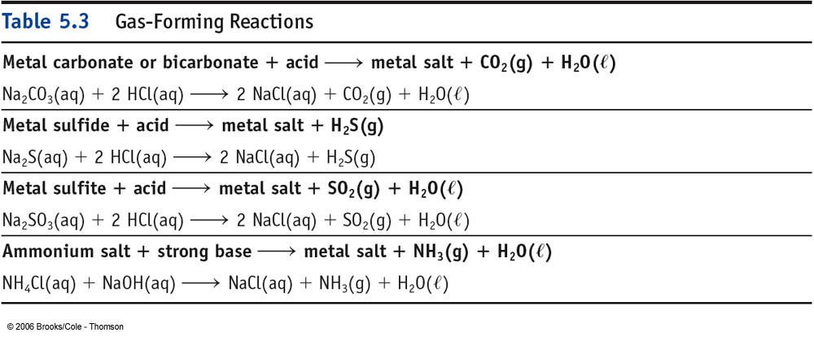

Slide 16
Hard water
2CH₃COOH(aq) + CaCO₃(s) → Ca(CH₃CO₂)₂(aq) + H₂O(l) + CO₂(g)

Slide 17
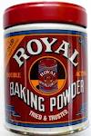
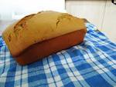
Backing biscuits or muffins
H₂C₄H₄O₆(aq) + HCO₃⁻(aq) → HC₄H₄O₆⁻(aq) + H₂O(l) + CO₂(g)
Tartaric acid hydrogen carbonate ion hydrogen tartrate ion

