Slide 1
STUDY SECTION
3.7
Oxidation-reduction reactions
This study section is based on chapter 3 in the textbook.
OUTCOMES
Following completion of this Study Section you should be able to:
Identify simple and general oxidation and reduction reagents (see Table 3.3 on p. 130);
Recognize a reaction as an oxidation-reduction-reaction (redox reaction);
Know what compound (atom) in a reaction is oxidized and what compound (atom) in the reaction is reduced;
Calculate the oxidation numbers of elements in a compound; and
Understand that the oxidation numbers represent the charge on an atom when the electrons of the compound are counted according to set of guidelines.

Slide 2
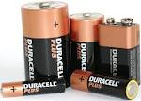
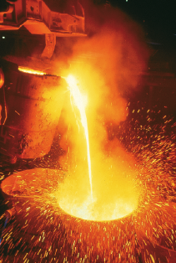
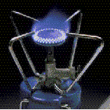
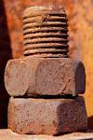
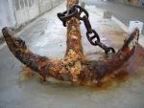
Why Study Redox Reactions
Batteries
Fuels
Metals manufacturing
Corrosion

Slide 3
oXidation-reduction reactions
Also named redox reactions
During oxidation-reduction reactions, electrons are transferred from one atom to another atom. When oxidation takes place, reduction MUST also take place.
Atoms undergo a change in change

Slide 4
Atoms that loses e⁻ are oxidized, and is the reducing agent
Reducing agent supplies e⁻
Cu → Cu²⁺ + 2e⁻ …………… oxidation half reaction
Atoms that wins e⁻ are reduced, and is the oxidizing agent
Oxidizing agent takes e⁻
Cu²⁺ + 2e⁻ → Cu …………… reduction half reaction

Slide 5
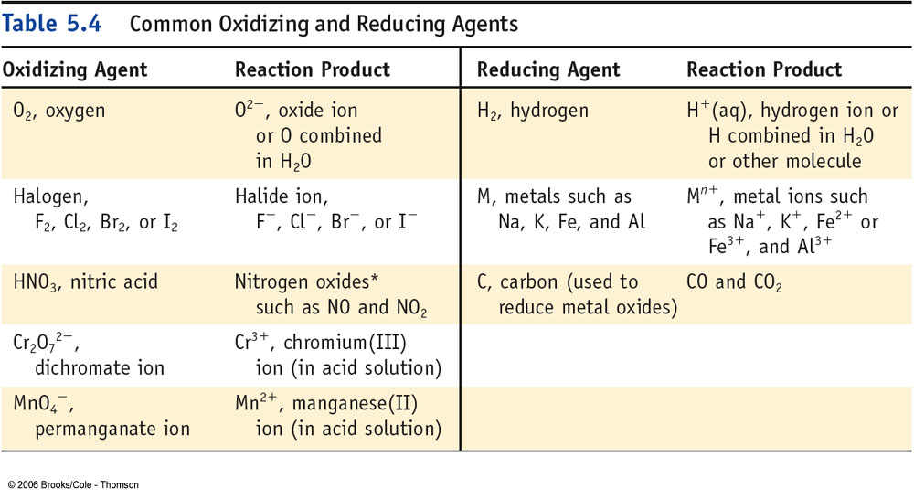
Table 3.3, p. 130

Slide 6
Identifiing a change in charge
Change in charge of atoms = Change in oxidation number of atoms

Slide 7
OXIDATION NUMBERS
Oxidation number of an atom, molecule or ion is the electrical charge that the atom, molecule or ion has according to a set of rules
1. Each atom in free element has ox. no. = 0.
Zn O₂ I₂ S₈
2. In simple ions, ox. no. = charge on ion.
-1 for Cl⁻ +2 for Mg²⁺

Slide 8
OXIDATION NUMBERS
3. O has ox. no. = -2
(except in peroxides: in H₂O₂, O = -1)
4. Ox. no. of H = +1
(except when H is associated with a metal as in NaH where it is -1)
5. Algebraic sum of oxidation numbers
= 0 for a compound
= overall charge for an ion

Slide 9
Try Yourself 3.8
Assign an oxidation number to the underlined atom in each of the following molecules or ions.
a) Fe₂O₃ b) H₂SO₄ c) CO₃²⁻

Slide 10
Recognizing Redox reactions
Assess whether the oxidation number of any of the elements in the reaction has changed.
Obvious redox reaction when uncombined element is converted to a compound.
Obvious redox reaction when well known oxidizing or reducing agent is involved.
Na releases 1 e⁻ per atom.
Oxidation number increases.
Na is oxidized to Na⁺ and is the reducing agent.
2 Na (s) + Cl₂(g) → 2 NaCl(s)
Cl₂ gains 2e⁻ per molecule.
Oxidation number decreases by 1 per Cl.
Cl₂ is reduced to Cl- and is the oxidizing agent.

Slide 11
Recognizing Redox reactions
Oxidation number of Cu changes from 0 to +2.
Cu is oxidized to Cu²⁺ and is the reducing agent.
Cu(s) + 2NO₃⁻(aq) + 4H₃O⁺(aq) → Cu²⁺(aq) + 2NO₂(g) + 6H₂O(l)
N in NO₃⁻ changes from +5 to +4 in NO₂.
NO₃⁻ is reduced to NO₂ and is the oxidizing agent.

Slide 12
Table 3.4, p. 130

Slide 13
Try Yourself 3.9
For the reaction of the iron(II) ion with permanganate ion in aqueous acid,
5Fe²⁺(aq) + MnO₄⁻ (aq) + 8H₃O⁺(aq) → 5Fe³⁺(aq) + Mn²⁺(aq) + 12H₂O(l)
Decide which atoms are undergoing a change in oxidation number and identify the oxidizing and reducing agents.

Slide 14
STUDY SECTION
Balancing of oxidation-reduction reactions
3.8
Study Section 3.8 is not part of Chapter 3, but part of the following chapters in the different textbook editions:
8th edition, Chapter 20, pages 896 – 903.
9th edition, Chapter 19, pages 715 – 723.
10th edition, Chapter 19, pages 859 – 865.
OUTCOMES
The video for SS 3.8 is only available in english.
Following completion of this Study Section you should:
Be able to balance oxidation-reduction reaction equations (redox reactions) in a neutral medium, acid medium and base medium through the use of the half-reaction approach.

Slide 15
BALANCING REDOX REACTIONS
Neutral medium:
Al(s) + Cu²⁺(aq) → Al³⁺(aq) + Cu(s)
1. Assign oxidation numbers
2. Write down the half reactions
3. Balance atoms for each reaction
4. Balance charge for each reaction
5. Equalize the electron transfer for both reactions
6. Add half reactions together
7. Make sure of the mass balance and charge balance

Slide 16
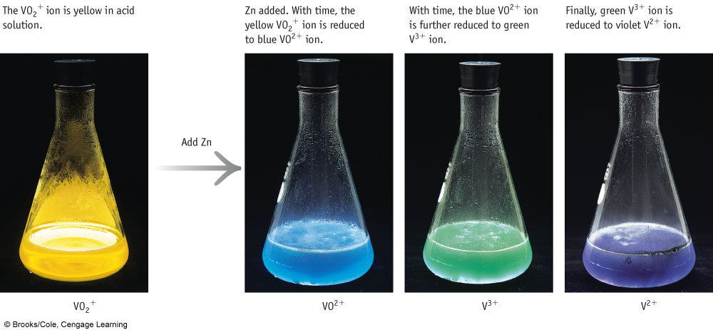
BALANCING REDOX REACTIONS
Acid medium:
VO₂⁺(aq) + Zn(s) → VO²⁺(aq) + Zn²⁺(aq)

Slide 17
BALANCING REDOX REACTIONS
Acidic medium:
1. Allocate oxidation numbers.
2. Write down half reactions.
3. Balance number of atoms for each reaction. Add H₂O to side with an O-shortage and H ⁺ to side with a H-shortage.
4. Allocate charge for each reaction.
5. Equalize electron transfer for both reactions.
6. Add half reactions together.
7. Check for mass and charge balance.
See the video on the balancing of a redox reaction in an acidic medium. The video is only available in English.

Slide 18
Correction on video 3.8
At around 25 minutes and 37 seconds in the video you will hear that the above mentioned “Try Yourself 3.10” question is a question in e-Test 3 – Redox reactions.
I say there that you must upload your answer to eFundi. THAT IS NOT VALID ANYMORE. THE VIDEO WAS MADE FOR LAST YEAR’S STUDENTS AND IT WAS AN E-TEST FOR THEM.

Slide 19
BALANCING REDOX REACTIONS
Alkaline/Basic medium:
1. Allocate oxidation numbers.
2. Write down half reactions.
3. Balance number of atoms for each reaction. Add OH ⁻ to side with an O-shortage and H₂O to side with a H-shortage.
4. Allocate charge for each reaction.
5. Equalize electron transfer for both reactions.
6. Add half reactions together.
7. Check for mass and charge balance.
See the video on balancing redox reactions in an alkaline/basic medium. The video is only available in English.

Slide 20
Correction on video 3.8
At around 27 minutes and 20 seconds in the video you will hear that the above mentioned “Try Yourself 3.11” question is a question in e-Test 3 – Redox reactions.
I say there that you must upload your answer to eFundi. THAT IS NOT VALID ANYMORE. THE VIDEO WAS MADE FOR LAST YEAR’S STUDENTS AND IT WAS AN E-TEST FOR THEM.

Slide 21
STUDY SECTION
Classification of reactions in aqueous solutions
3.9
This study section is based on chapter 3 in the textbook.
OUTCOMES
Following completion of this Study Section you should:
Be able to recognize the core characteristics of the four types of reactions (precipitation, acid-base, gas-forming and redox) in aqueous solutions.

Slide 22
Recognizing reactions in aqueous solution
Presipitation Reactions
Soluble ions combine in solution to form an insoluble product.
Pb(NO₃)₂(aq) + 2KI(aq) → PbI₂(s) + 2KNO₃(aq)
Acid-Base Reactions
Water is a product of many acid-base reactions and the cation of the base and the anion of the acid form a salt.
HNO₃(aq) + KOH(aq) → HOH(l) + KNO₃(aq)

Slide 23
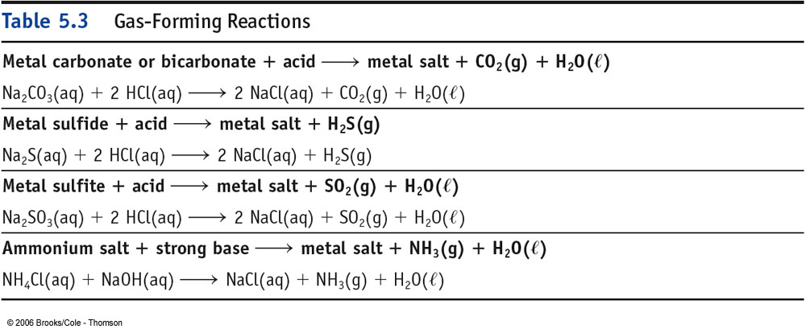
Recognizing reactions in aqueous solution
Gas-Forming Reactions

Slide 24
Recognizing reactions in aqueous solution
Oxidation-Reduction Reactions
These reactions are not ion exchange reactions. Electrons are transferred from one material to another.
Na releases 1 e⁻ per atom.
Oxidation number increases.
Na is oxidized to Na⁺ and is the reducing agent.
2 Na (s) + Cl₂(g) → 2 NaCl(s)
Cl₂ gains 2e⁻ per molecule.
Oxidation number decreases by 1 per Cl.
Cl₂ is reduced to Cl- and is the oxidizing agent.

