Slide 1
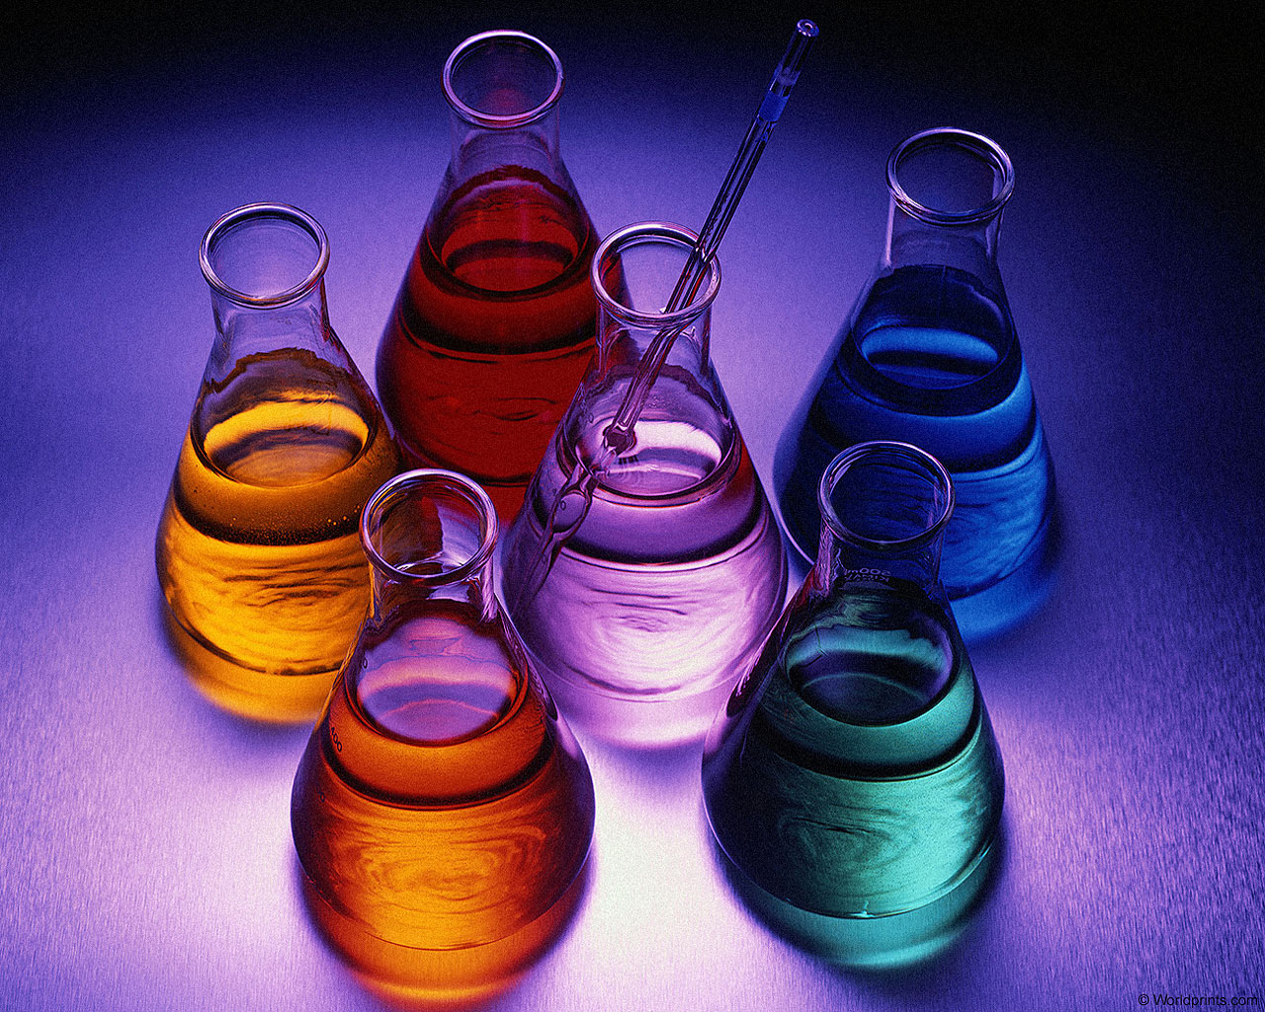
STUDY UNIT 3
CHEMICAL REACTIONS
KT & T, p. 96 - 137 and 715 - 723
Study guide, Study units 3.1 – 3.9, p. 22 - 31

Slide 2
STUDY SECTION
INTRODUCTION:
Balancing of chemical equations
3.1
This study section is based on chapter 3 in the textbook.
OUTCOMES
Following completion of this Study Section you should be able to:
Balance simple chemical equations by means of inspection; and
Use the information in a balanced chemical equation.

Slide 3
CHEMICAL REACTIONS
Reactants: Zn + I₂
Product: Zn I₂

Slide 4
Chemical Equations
Depict the kind of reactants and products and their relative amounts in a reaction.
4 Al(s) + 3 O₂(g) → 2 Al₂O₃(s)
Mole ratio
between reactants
and products
Stoichiometric coefficients
Physical states of reagents and products

Slide 5
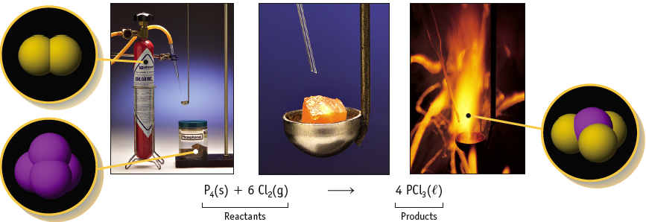
Reaction of Phosphorus with Cl₂
Notice the stoichiometric coefficients and the physical states of the reactants and products.

Slide 6
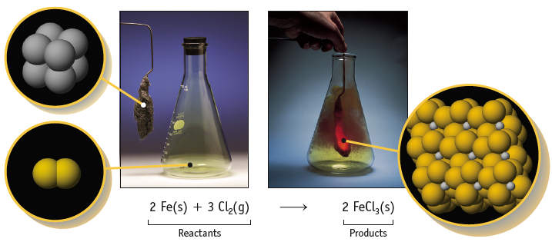
Reaction of Iron with Cl₂
Notice the stoichiometric coefficients and the physical states of the reactants and products.

Slide 7
CHEMICAL REACTIONS
Try Yourself 3.1
Name the reactants and products and give their
physical states.
What are the stoichiometric coefficients in this equation?
If you were to use 8000 atoms of Al, how many molecules
of Br₂ are required to consume the Al completely?

Slide 8
Chemical Equations
4 Al(s) + 3 O₂(g) → 2 Al₂O₃(s)
This equation means:
4 Al atoms + 3 O₂ molecules --give→ 2 “molecules” of Al₂O₃
It also means:
4 moles of Al + 3 moles of O₂ --give→ 2 moles of Al₂O₃

Slide 9
Chemical Equations
Because the same atoms are present in a reaction at the beginning and at the end, the amount of matter in a system does not change.
The Law of the Conservation of Matter
2HgO(s) → 2 Hg(l) + O₂(g)

Slide 10
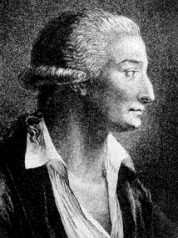
Chemical Equations
Because of the principle of the conservation of matter,
an equation must be balanced.
It must have the same number of atoms of the same kind on both sides.
Lavoisier, 1788

Slide 11
Chemical Equations
Formulas for reactants and products must be correct or the equations is meaningless.
Subscripts in formulas cannot be changed to balance equations. Changing
subscripts changes the identity of the substance. You cannot change CO₂ to CO to balance an equation.
Chemical equations are balanced using stoichiometric coefficients. The entire chemical formula of a substance is multiplied by the stoichiometric coefficient.
3CO₂(g) means there are 3 C-atoms AND 6 O-atoms

Slide 12
Balancing Equations via inspection
Al(s) + Br₂(l) → Al₂Br₆(s)
2
3

Slide 13
Balancing Equations via inspection
1
5
3
4
___C₃H₈(g) + ___ O₂(g) → ___CO₂(g) + ___ H₂O(g)

Slide 14
Probeer self 3.2
Balance the following equations

Slide 15
Probeer self 3.3
Write a balanced chemical equation for the combustion
of butane, C₄H₁₀.

Slide 16
STUDY SECTION
3.2
INTRODUCTION TO CHEMICAL EQUILIBRIUM
We will do a full investigation into Chemical equilibrium in Study Unit 7.

