Slide 1
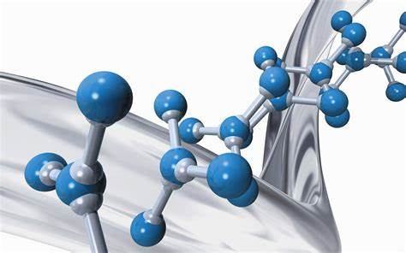
NCHE 111: Introduction to Inorganic and Physical Chemistry
STUDY UNIT A
BUILDING BLOCKS OF CHEMISTRY
Five Study Units
Study Unit 1: Basic concepts of chemistry
Study Unit 2: Atoms, molecules and ions
Study Unit 3: Chemical reactions
Study Unit 4: Stoichiometry: Quantitative info about chemical reactions
Study Unit 5: Energy and chemical reactions
Kotz, Treichel & Townsend, gedeeltes van hoofstukke. 1, 2, 3, 4 en 5
Studiegids bl. 1 - 49, Leereenhede 1, 2, 3, 4 & 5

Slide 2

STUDY UNIT 4
MASS RELATIONS IN CHEMICAL REACTIONS: STOICHIOMETRY
KT & T, bl. 139 – 179 and 470 - 473
Study guide, Study Sections 4.1 – 4.7, p. 33 - 40

Slide 3

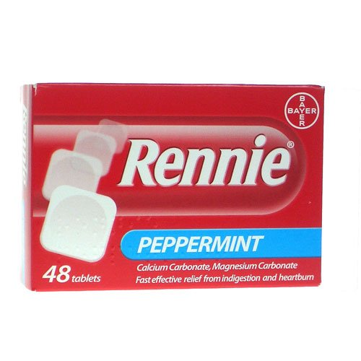


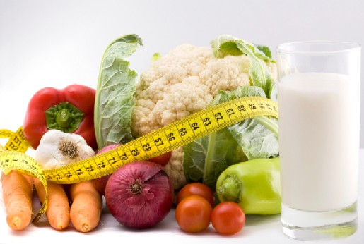
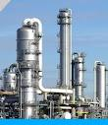

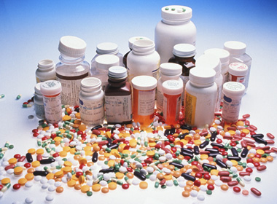
WHY STUDY STOICHIOMETRY?

Slide 4
STUDY SECTION
MASS RELATIONS IN CHEMICAL REACTIONS: STOICHIOMETRY
4.1
This study section is based on KT&T, chapter 4.
OUTCOMES
Following completion of this Study Section you should be able to:
Understand the principles of the retention of matter – what the basis is of chemical stoichiometry;
Calculate the mass of mole amount of one reagent or product from the mass of the mole amount of another reagent or product by making use of a balanced chemical equation. You should also be able to switch between mass amounts and mole amounts; and
Use quantity tables to order stoichiometric information.

Slide 5
What is meant by the word “Stoichiometry”
The relationship between amount of reagents and products
Stoichiometric coefficients: coefficients in a balanced equation
4Al(s) + 3O₂ → 2Al₂O₃(s)

Slide 6
STOICHIOMETRY
It rests on the principle of the conservation of matter.
2 Al(s) + 3 Br₂(liq) → Al₂Br₆(s)

Slide 7
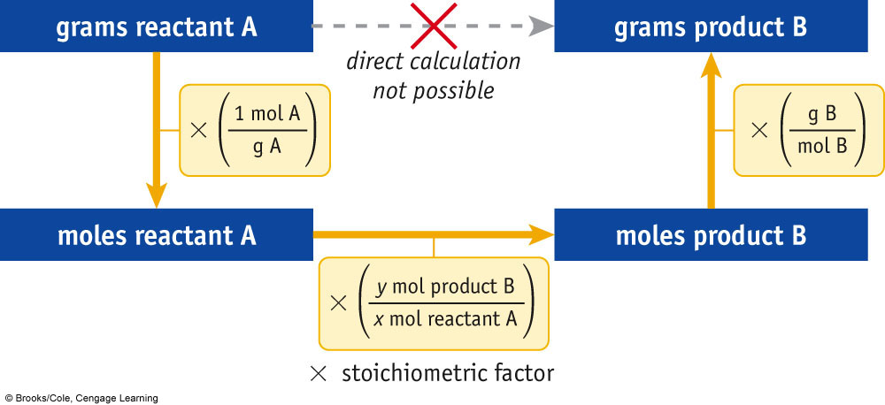
REACTION:
xA → yB

Slide 8
Example
Iron reacts with oxygen to give iron(III) oxide, Fe₂O₃.
Write a balanced equation for this reaction.
If an ordinary iron nail (assumed to be pure iron) has a mass of 2.68 g, what mass (in grams) of Fe₂O₃ does it produce if the nail is converted completely to this oxide?
What mass of O₂ (in grams) is required for the reaction?

Slide 9
Try Yourself 4.1
Consider the following unbalanced equation.
BaCl₂(aq) + AgNO₃(aq) → AgCl(s) + Ba(NO₃)₂(aq)
1. Write the balanced equation
What mass of AgNO₃, in grams, is required for complete reaction with 0.156 g of BaCl₂?
3. What mass of AgCl in grams, is produced?

Slide 10
STUDY SECTION
Reactions in which one reagent is present in limited amount (limiting reagents)
4.2
This study section is based on KT&T, chapter 4.
OUTCOMES
Following completion of this Study Section you should be able to:
Calculate which of or two reagents is a limiting reagent; and
Calculate the yield of a product based on the limiting reagent.

Slide 11
LIMITING REAGENTS
In chemical reactions the purpose is to get the maximum yield of an useful product.
To ensure that:
The cheaper reagent is used in excess in the reaction, thus ensuring that the expensive reagent (limiting reagent) is completely transformed to product.
In a given reaction, there is not enough of one reagent to use up the other reagent completely.
The reagent in short supply LIMITS the quantity of product that can be formed.

Slide 12
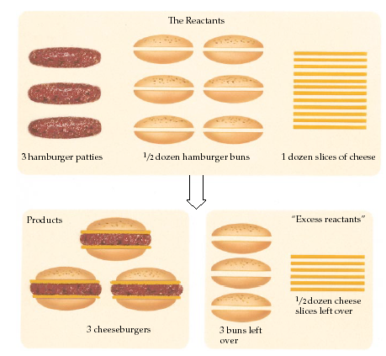
Reactions Involving a LIMITING REACTANT

Slide 13
Example
Reactants
Products
2NO(g) + O₂ (g) 2NO₂(g)
Limiting reagent =
NO(g)
O₂ (g)
Excess reagent =

Slide 14
Example
The compound SF₆ is made by burning sulfur in an atmosphere of fluorine. The balanced equation is:
S₈(s) + 24 F₂(g) → 8 SF₆(g)
If you begin with 1.6 mol of sulfur, S₈, and 35 mol of F₂ which is the limiting reagent?

Slide 15
Try Yourself 4.2 a
  TiCl₄ is an important industrial chemical that can be prepared from TiO₂ during a reaction with carbon and chlorine gas. In the preparation of TiCl₄ equal amounts of chlorine gas and carbon (125 g each) and an excess of TiO₂ was used.
TiO₂(s) + C(s) + Cl₂(g) → TiCl₄(s) + CO₂(g)
Identify the limiting reagent.
What is the mass TiCl₄ that can be formed?

Slide 16
Try Yourself 4.2 b
  Aluminium chloride, AlCl₃, is an inexpensive reagent used in many industrial processes. It is made by treating scrap aluminium with chlorine according to the following balanced equation:
  2Al(s) + 3Cl₂(g) → 2AlCl₃(s)
  Which reactant is limiting if 2.70 g of Al and 4.05 g of Cl₂ are mixed?
  What mass of AlCl₃ can be produced?
  What mass of the excess reagent remains when the reaction is completed?

Slide 17
STUDY SECTION
4.3
Percentage yield
This study section is based on KT&T, chapter 4.
OUTCOMES
Following completion of this Study Section you should be able to:
Understand and describe the difference between real yield, theoretical yield and percentage yield; and
Calculate the real yield, theoretical yield and percentage yield.

Slide 18
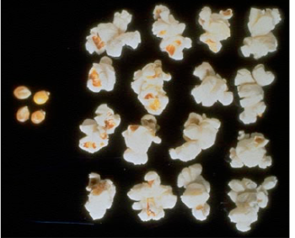
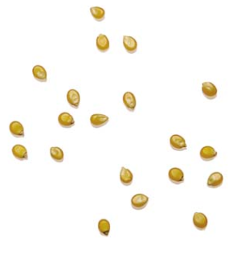
16 ‘pop’
20 pips
% Yield = (16/20) x 100%
= 80%

Slide 19
Same principle for chemical reactions
Zn(s) + 2HCl(aq) ZnCl₂(aq) + H₂(g)
Mol (theoretical):
1 1
Mass in g (theoretical):
65.39 136.29
Suppose the real yield of ZnCl₂ is 120g (0.88 mol)
% Yield:
(0.88 mol/1 mol) x 100% = 88%
OR:
(120g/136g) x 100% = 88%

Slide 20
You should be able to explain the difference between:
exact yield / Real yield
theoretical yield
percent yield
Calculate:
percent yield

Slide 21
Theoretical vs Real Yield
The theoretical yield is the amount of product that should be yielded from the chemical reaction.
During a chemical reaction a part of the product can be lost due to practical problems.
The real yield is therefore not equal to the theoretical yield.

Slide 22
Percentage Yield
To calculate the effectiveness of a chemical reaction
Percentage yield = (real yield / theoretical yield) x 100
Implications for industry:
Production
Cost

Slide 23
Try Yourself 4.3 a
  Methanol can decompose to hydrogen gas that can be used as a fuel.
  CH₃OH() → 2H₂(g) + CO(g)
(a) If 125 g methanol decomposes, what is the theoretical yield of hydrogen?
(b) If only 13.6 g hydrogen is obtained, what is the percentage yield of the gas?

Slide 24
If 454 g of NH₄NO₃ decomposes, theoretically 204 g of H₂O should be formed. Determine the theoretical yield of N₂O. Calculate the percent yield of N₂O if 131 g is the actual yield.
Try Yourself 4.3 b

Slide 25
